Slide 1

Advancing Patient Outcomes through Diabetes Prevention and Management Programs in Ohio
Copyright 2026
Notes:
Good afternoon everyone, and welcome. Thank you for joining us for today’s webinar:
“Advancing Patient Outcomes through Diabetes Prevention and Management Programs in Ohio.”
Before we get started, just a few quick housekeeping notes:
This session is being recorded and will be made available after the webinar.
You’ll also notice that the chat feature is turned off for today’s webinar. If you have any questions during the presentation, please use the Q&A panel at the bottom of your Zoom window. We’ll be monitoring questions throughout and will address as many as we can during the Q&A portion at the end.

Slide 2
Claiming CE
Access link + code sent after session
Enroll in the course using the link
Enter access code to unlock content
Complete knowledge checks and evaluation
Claim credit and download certificate
Notes:
Before we move on, I want to quickly walk through how to claim your continuing education credit for today’s session.
After the webinar, you’ll receive a follow-up email with a link and an access code.
You’ll use that link to enroll in the course, and when prompted, enter the access code to unlock the content.
Once you’re in, you’ll just need to complete the knowledge checks and the evaluation.
After that, you’ll be able to claim your credit and download your certificate directly.

Slide 3
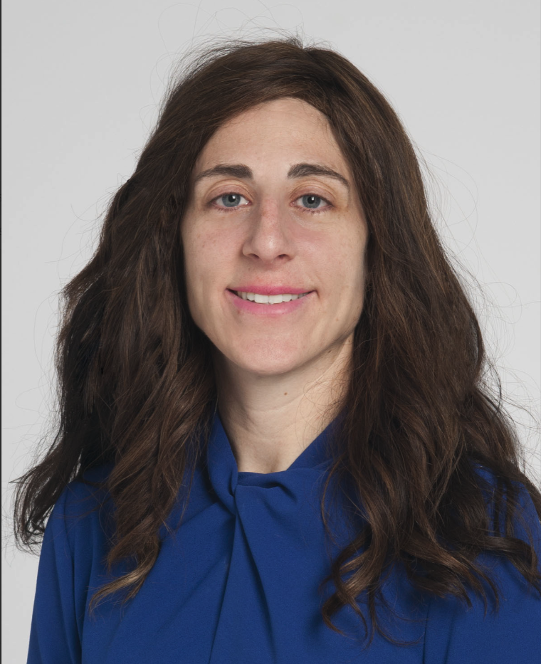
Instructor #1
Diana Isaacs, PharmD, BCACP,
CDCES, BC-ADM, FADCES, FCCP
Diana Isaacs, is an Endocrine Clinical Pharmacist at the Cleveland Clinic. She serves as the Co-Director of Endocrine Disorders in Pregnancy and the Director of Education and Training in Diabetes Technology at the Cleveland Clinic Endocrinology and Metabolism Institute.
Dr. Isaacs holds board certifications in ambulatory care and advanced diabetes management. She served on the American Diabetes Association (ADA) Professional Practice Committee from 2020-2023, the committee that updates the ADA Standards of Care. She also was the ADA Communications Director for the Pregnancy and Reproductive Health Interest Group from 2018-2022. She has been actively involved with the American Association of Clinical Endocrinology (AACE) and currently serves on the leadership of the Diabetes Disease State Network and Board of Directors.
She co-hosts a podcast titled “Diabetes Dialogue: Technology, Therapeutics and Real-World Perspectives.” She advocates access and choice to the latest technologies and therapeutics for all people with diabetes and speaks on diabetes related topics nationally and internationally. She was the ADCES Diabetes Care and Education Specialist of the Year in 2020 and inducted into the SIUE Alumni Hall of Fame in 2022 for her far-reaching contributions in diabetes care.

Slide 4
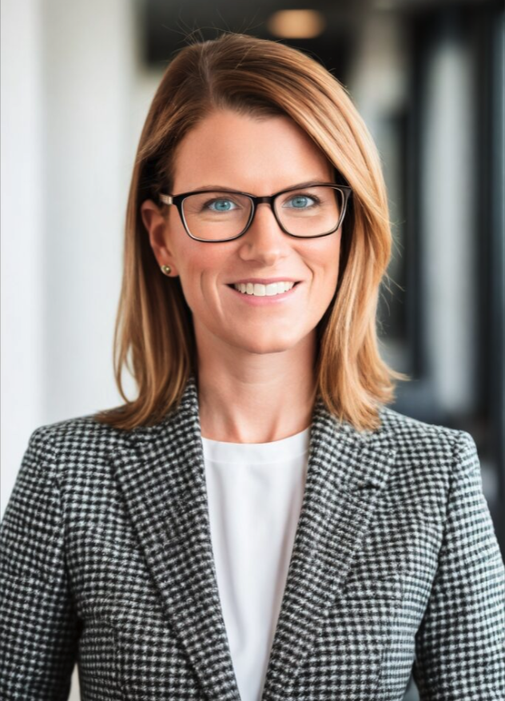
Instructor #2
Cathleen McKnight, DNP, APRN, FNP,
PMHNP, MSCP
Dr. Cathleen McKnight is a doctorally prepared, dually board certified family (FNP) and psychiatric mental health nurse practitioner (PMHNP). Dr. McKnight carries a Certificate of Advanced Education in Obesity Medicine from the Obesity Medicine Association (OMA), is a Menopause Society Certified Practitioner (MSCP), and is a Certified Professional in Patient Safety (CPPS).
Her professional experiences include labor & delivery/high-risk obstetrics, primary care, women’s health, psychiatric mental health, clinical operations, quality programs, professorship, corporate leadership, retail health and clinical pharmacy advancement, concierge care, and healthcare product and services advising.
Dr. McKnight believes in a simplified, holistic healthcare approach to helping people and populations on their wellness journey. She is also passionate about elevating innovative interdisciplinary models of care to better serve patients and communities

Slide 5
Relevant Financial Relationships
Diana Isaacs has had relevant relationships as a speaker with Dexcom, Abbott, Lilly, Novo Nordisk, Sequel, Sanofi, Insulet, Cequr, and Beta Bionics. She also is a consultant for Tandem and Minimed.
Cathleen McKnight has no relevant financial relationships with ineligible companies to disclose.
The course planners have no financial disclosures or conflicts.
All relevant financial relationships have been mitigated.

Slide 6
Anti-Discrimination Policy
The instructors and advisors have agreed to our anti-discrimination policy that
prohibits the inclusion of discriminatory language, graphics, or references on the basis of race, gender identity, age, color, national origin, physical or mental disability, or religion.

Slide 7
Learning Objectives
By the end of this course, the learners will be able to:
Differentiate how DSMES and the DPP complement traditional primary care and endocrinlogy-based diabetes management as catalysts for sustained behavior change and improved long-term outcomes.
Evaluate the impact of DSMES and DPP on patient outcomes, including prevention, glycemic management, cardiometabolic risk reduction, patient activation, and health equity.
Apply interprofessional, team-based strategies to integrate DSMES and DPP intro clinical and community workflows across Ohio.

Slide 8
LO#1
Differentiate how DSMES and the DPP complement traditional primary care and endocrinology-based diabetes management as catalysts for sustained behavior change and improved long-term outcomes.

Slide 9
40.1 million people in the US have diabetes (12%).​
115.2 million people have prediabetes.​
39.8 million adults in the US have diabetes (14.9%).​
The Latest Diabetes and Obesity Stats
About 1 in 5 children live with obesity
58% of U.S. adults with obesity have high blood pressure, a risk factor for heart disease
23% of U.S. adults with obesity have diabetes
Obesity occurs in 41.9% of all adults
Diabetes occurs in 14.9% of all adults
CDC, 2024

Slide 10
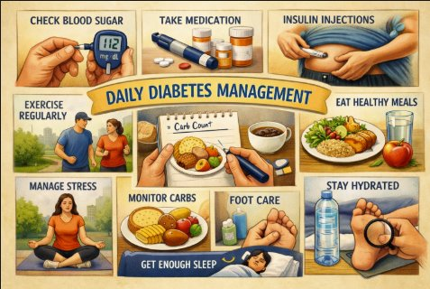
Diabetes Management
Time spent with a healthcare professional in comparison to time spent in daily diabetes self-management is less than 1%.
On average, people get 15 minutes every 3 months with their primary care provider or endocrinologist.
Diabates management is not easy.

Slide 11
Food
Medication
Activity
Biological
Environmental
Behavioral and Decision Making
Factors Affecting Glucose
↑↑ Carbo-hydrate quantity​
→↑Carbo-hydrate type​
→↑ Fat​
→↑ Protein​
→↑ Caffeine​
↓↑Alcohol​
↓↑ Meal timing​
↑Dehydration​
? Personal microbiome​
→↓Dose​
↓↑ Timing​
↓↑ Inter-actions​
↑↑ Steroid administration​
↑ Niacin (vitamin B3)​
→↓ Light exercise​
↓↑ High/moderate exercise​
→↓ Level of fitness/training​
↓↑ Time of day​
↓↑ Food and insulin timing​
↑ Insufficient sleep​
↑ Stress and illness​
↓ Recent hypoglycemia​
→↑ During-sleep blood sugars​
↑ Dawn phenomenon​
↑ Infusion set issues​
↑ Scar tissue and lipodystrophy​
↓↓ Intramuscular insulin delivery​
↑ Allergies​
↑ A higher glucose level​
↓↑ Menstruation​
↑↑ Puberty​
↓ Celiac disease​
↑ Smoking​
↑ Expired insulin​
↑ Inaccurate BG reading​
↓↑ Outside temperature​
↑ Sunburn​
? Altitude​
↓ Frequency of glucose checks​
↓↑ Default options and choices​
↓↑ Decision-making biases​
↓↑ Family relationships and social pressures​
Brown, 2022

Slide 12
Diabetes Self-Management Education and Support (DSMES)
Provides an evidence-based foundation to help people with diabetes navigate their condition.
People who participate in DSMES have been shown to have better diabetes-related outcomes than those who do not.
Despite this, less than 5% of Medicare beneficiaries and 6.8% of privately insured people with diabetes have used DSMES within the first year of diagnosis.
CDC, 2024​

Slide 13
DSMES Objectives
Provides people with diabetes the knowledge, skills, and confidence to manage diabetes
This includes:
  Active collaboration with the healthcare team
  Making informed decisions
  Solving problems
  Developing personal goals and action plans
  Coping with emotions and life stresses
Powers et al., 2020​

Slide 14
DSMES Promotes Self-Care Behaviors
ADCES7 Self-Care Behaviors
  Healthy eating
  Being active
  Monitoring
  Taking medication
  Healthy coping
  Problem solving
  Reducing risks
”All people with diabetes should participate in diabetes self-management education and support to facilitate the knowledge, decision-making, and skills mastery necessary for diabetes self-care.”
- ADA Standards of Care
Powers et al., 2020
Kolb, 2020

Slide 15
Critical Times to Provide and Modify DSMES
Diagnosis
When complicating factors develop
Annually and/or when not meeting treatment targets
When transitions in life and care. occur
Powers et al., 2020​

Slide 16
LO#2
Evaluate the impact of DSMES and DPP on patient outcomes, including prevention, glycemic management, cardiometabolic risk reduction, patient activation, and health equity.

Slide 17
Successful DSMES Programs
Involves group and individual education
Provided by a team vs single individual
Participants attend > 10 hours
Tailored to the individual participant
Focused on behaviors and engages the participant rather than didactic lectures
Powers et al., 2020​

Slide 18
Diabetes Prevention Program DPP
Purpose: Prevent or delay the onset of type 2 diabetes in at-risk individuals and reduce progression of prediabetes through sustained lifestyle modification
Intensive preventive behaviors that become automatic over time, with emphasis on momentum, accountability, and long-term maintenance to avert disease onset
Focus Areas
  Weight loss
  Dietary changes
  Physical activity
  Behavior change strategies (goal setting, self-monitoring, social support)
  Risk reduction metrics (glucose tolerance, A1c, waist circumference)
CDC, 2024

Slide 19
Catalyst for Behavior Change
Person-centered programs
Ongoing sustained engagement rather than a one-time intervention
DSMES and DPP serve as essential behavioral intervention frameworks that extend beyond traditional medical management by addressing the daily decision-making, skill building, and sustained lifestyle modifications required for optimal outcomes
DSMES goes beyond routine diabetes care by providing structured education and support to help patients effectively manage their condition

Slide 20
What Happens in these Programs?
Assess cultural influences, social determinants of health, health beliefs, current knowledge, physical limitations, family support, financial and work status, medical history, learning preferences and barriers, literacy, and numeracy
Medication: choices, access, action, titration, and side effects
Monitoring blood glucose: when to check, interpreting and using glucose pattern management for feedback
Physical activity: safety, short-term vs. long-term
Preventing, detecting, and treating cute and chronic complications
Powers et al., 2020​

Slide 21
Individualized Care & Education
Nutrition: Food plan, planning meals, purchasing food, preparing meals, portioning food
Risk reduction: Smoking cessation, foot care, cardiac risk
Developing personal strategies to address psychosocial issues and concerns, adjusting to a life with diabetes
Developing personal strategies to promote health and behavior change
Problem identification and solutions
Identifying and accessing resources
Powers et al., 2020​

Slide 22
Meet Gerald
Gerald is 56 years old. He has obesity and prediabetes. He was told by his PCP that physical activity improves health. He thinks that sounds nice, but he says there is no time in his busy schedule. He also was advised to “eat healthier.”
His employer provides a free Diabetes Prevention Program delivered by a local pharmacy in his neighborhood.
Admittedly, he thinks this is going to be a waste of time because his doctor told him what he needs to do, he just needs to find a way to do it. However, he agrees to try it out because his doctor thought it would be a good idea. His next appointment is not for 6 months.

Slide 23
Discussing Activity with Gerald
Principal | Action
Ask | Ask permission to discuss physical activity
Assess | Assess current activity level through open-ended questions; explore drivers and complications for lack of physical activity
Advise | Advise on health benefits of physical activity
Agree | Agree on realistic physical activity goals
Arrange/Assist | Arrange/assist in identifying barriers, provide resources, and arrange follow-up
Shreiner, 2019

Slide 24
Motivational Interviewing Conversation
Step | Case | Response
Engaging | “As much as I want to eat better, following my meal plan is hard because there are always doughnuts and other treats at work.” | “It sounds as if it is important to you to eat better, but you are finding it tough to do with the tempting foods at work. On a scale of 1 to 10, with 1 not important at all and 10 very important, how important is it for you to make a change in how you are eating?
Focusing | “It’s about an 8.” | “An 8 is a high number, so it is pretty important to you to eat better.”​
Evoking | “Yes, I went a few days without eating the office treats, but there is so much peer pressure.” | “Would you be interested in hearing some ideas that have worked for other people who have struggled with a similar problem?”​
Planning | “I like the idea you suggested of bringing a healthy treat to work.” | “What is something you might do in the next few days to get started on this?”​
Shreiner, 2019​

Slide 25

Gerald’s Follow-Up
“I thought this program would be a waste because I already knew what to do, but it is so easy to get stuck in habits and it is hard to make changes. They found a way to help that truly worked for me."
He returns to his doctor 6 months later with positive feedback on the experience.
He has started playing pickle ball 3 times a week.
He used to skip breakfast, but now starts each day with an English muffin and egg.
He is snacking less in the evening.
He has also lost 10lbs.

Slide 26
Benefits of DSMES
Improved A1C and time in range
Improved blood pressure and cholesterol levels
Higher rates of medication refills/improved medication taking behaviors
Fewer or less severe diabetes related complications
Reduced hypoglycemia
Improved quality of life
Healthier lifestyle behaviors (better nutrition, increased physical activity, and use of primary care and preventive services)
Enhanced self-efficacy and empowerment
Decreased healthcare costs, including fewer hospital admissions and readmissions
Increased healthy coping
CDC, 2026

Slide 27
Benefits of DPP
Reduces risk of type 2 diabetes by 50%
In those aged 60+, risk reduction was even greater – about 70%
Reduces risk of microvascular complications of diabetes
Reduces healthcare costs
Participants typically achieve 5%-7% body weight loss, consistent with major clinical DPP benchmarks
“This program has taught me how to eat healthy and find an exercise routine that works for my schedule.”
”Having a group of people with the same goals as me really motivated me to jump-start healthy lifestyle changes.”
Zhou et al., 2020
CDC, 2024

Slide 28
Case
Studies

Slide 29
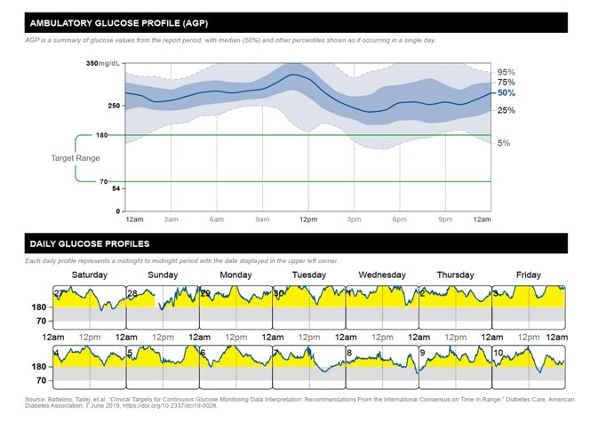
Case Study #1
Demographics
Alex is a 52-year-old Black male
Not currently employed
Insurance: Medicaid
Medical History
Recent type 2 diabetes diagnosis 6 months ago
HbA1c: 10.1% (baseline)
Comorbidities: Hyperlipidemia, hypertension
Current Therapy
Glargine 20 units daily
Metformin 100mg BID

Slide 30
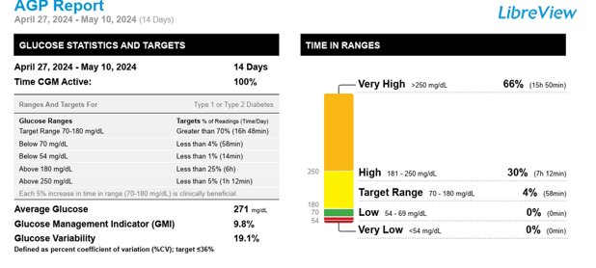
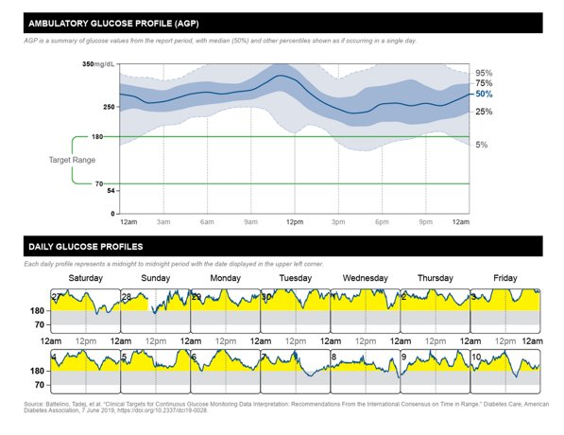
Case Study #1
Today, Alex’s PCP increased the insulin to 24 units daily and referred to DSMES.
B
A
C

Slide 31
Case Study #1: DSMES Intervention
Alex reports he has his insulin, he paid $0 for it.
He has not picked up any refills yet, but reports rarely missing doses, maybe 1 in the last 2 weeks.
The DCES reviews injection technique, has Alex practice and it turns out he was not pressing down the top of the pen so it was not actually delivering any insulin.
Alex learned the correct technique and started taking the insulin as directed.

Slide 32
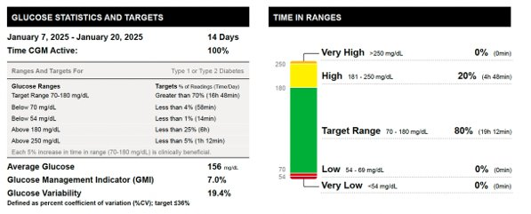
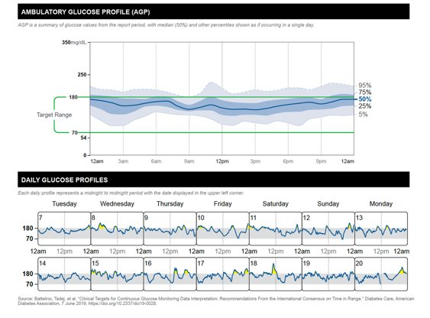
Case Study #1 Follow-Up

Slide 33
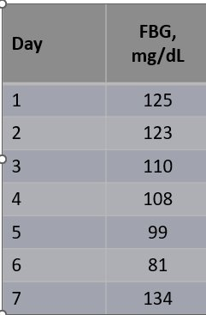
Case Study #2
Tiffany is a 60yr old woman with T2D x 5 years who works as an administrative assistant 40hrs/week, sitting most of the time. She eats 3 meals/day, snacks at night, does not regularly exercise, and checks BGM once daily.
Current DM2 meds
  Metformin 1000 mg twice daily
  Dapagliflozin 10mg daily
  Previously tried a GLP-1 and experienced emesis/diarrhea
Other conditions
  Hyperlipidemia
  Hypertension
Pertinent Labs: A1C = 8.2%, eGFR = 55, BMI = 34 kg/m²
Glucose Log:

Slide 34
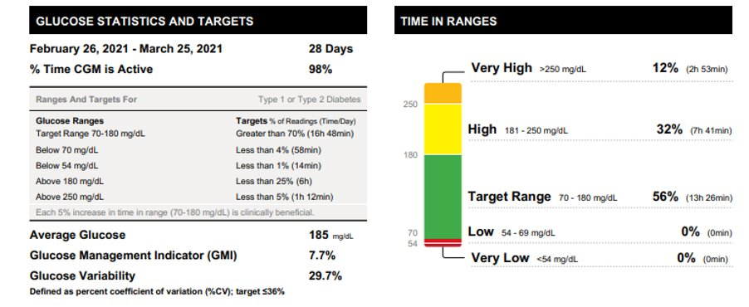
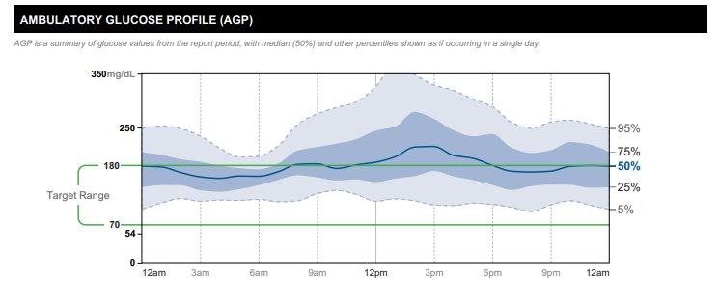
Case Study #2: Starts CGM
Tiffany’s PCP started her on CGM since A1C was not matching BGM.
Also referred to DSMES to train on using CGM and address lifestyle behaviors.
Follow-up visit in 3 months.

Slide 35
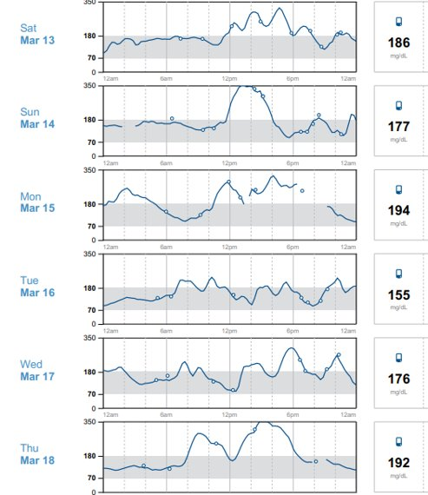
Case Study #2: DSMES Intervention
The DCES trains Tiffany on how to use the CGM
At the follow-up visit, they review patterns together
Sunday 3/14, glucose went high at 12pm
Reports eating rice bowl and coke
Silver lining:
  Walked around 3pm (helped lower glucose)
  Avoided afternoon snacking and ate low-carb dinner (salmon, salad, small potato)
  Denies missed doses

Slide 36
Case Study #2: Next Month
In collaboration with Tiffany:
  Lifestyle changes:
    Incorporate a brisk walk 3 days per week, 20-30 minutes
    Reduce high-carbohydrate foods like fries and rice and eating more balanced meals (protein + veggie at most meals)
    Lost 7lbs
  CGM optimization:
    Alerts, high for 200

Slide 37
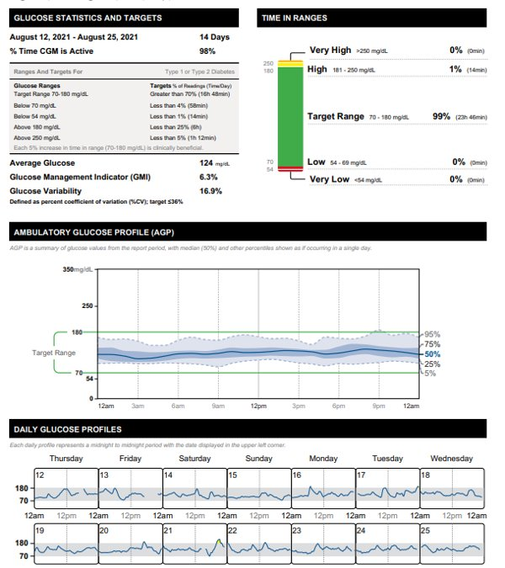
Case Study #2:
PCP Follow-Up
No med changes
Lost 12lbs
A1C improved to 6.8%

Slide 38
Self-
Assessment

Slide 39
Self-Assessment Question
KC is a 66-year-old woman with type 2 diabetes for 8 years. She previously attended diabetes education when she was diagnosed and has not had education since then. Her most recent A1C is 8.2%. Which of the following are reasons KC may benefit from DSMES?
Learn about new technologies that are available
Improve regularity of glucose monitoring
Determine individualized strategies to eat more regular, healthy meals
All of the above

Slide 40
Self-Assessment Question
KC is a 66-year-old woman with type 2 diabetes for 8 years. She previously attended diabetes education when she was diagnosed and has not had education since then. Her most recent A1C is 8.2%. Which of the following are reasons KC may benefit from DSMES?
Learn about new technologies that are available
Improve regularity of glucose monitoring
Determine individualized strategies to eat more regular, healthy meals
All of the above

Slide 41
Conclusions
There are many evidence-based benefits of DSMES and DPP.
DSMES and DPP complement traditional primary care and endocrinology-based diabetes management and lead to sustained behavior change and improve long-term outcomes.
Critical times to provide and modify DSMES are at diagnosis, annually or when not meeting treatment targets, when complicating conditions occur, and during transitions of care.

Slide 42
LO#3
Apply interprofessional, team-based strategies to integrate DSMES and DPP into clinical and community workflows across Ohio.

Slide 43
Why DSMES and NDPP Integration Matters
Ohio adults (ADA, 2023):
  1 in 3 with prediabetes
  Over 12% diagnosed with diabetes
Drives avoidable hospitalizations, ED visits, and long-term complications
Evidence-based and underutilized
Expand reach
Supports underserved (virtual, in-person, and hybrid offerings)
Improves self-management, adherence, and outcomes
Reduces costs of care and wait times across primary and specialty services (Kuo et al., 2025)

Slide 44
For Healthcare Providers
Maintains vertical integration while increasing support for patients
Allows healthcare providers & other primary managers in care to maintain oversight
Reduces workload
Preserves clinic revenue

Slide 45
Economic Impact
NDPP
$4,552 lower healthcare costs per participant.
NDPP participants had lower total medical spending than similar patients who did not enroll (Kuo et al. 2025)
DSMES
Lower prescriptions costs than those who had DSME: $4,398.19 vs. $3,966.82
Lower total medical costs by 16%
Lower total prescription costs by 13% (Lv et al., 2025)

Slide 46
NDPP & DSMES Metrics that Matter
Metric Category | Key Measures | Impact
Clinical Outcomes | • A1C reduction (0.6–1.3%) ​ • 5–7% weight loss ​ • Increased physical activity (≥150 min/week) | Improves diabetes control and reduces complications​ (Flatt et al., 2020).
Diabetes Prevention | • Reduced conversion from prediabetes to diabetes (58%)​ | Prevents future chronic disease burden​ (NIDDK, 2021).
HEDIS Quality Measures | • HbA1c control (<8%) ​ • Blood pressure control in diabetes ​ • Comprehensive diabetes care | Improves health plan quality scores​ (NCQA, 2025)
Medicare Star Ratings | • Diabetes blood sugar control ​ • Medication adherence for diabetes medications | Improves Medicare Advantage performance​ (CMS, 2025a).
Population Health Impact | • Reduced hospitalizations ​ • Improved self-management behaviors ​ • Lower long-term healthcare costs | Supports value-based care models​ (CDC, 2024).

Slide 47
NDPP & DSMES Providers
Hospital DSMES programs
FQHC lifestyle programs
Community organizations (YMCA, public health departments)
Retail and community pharmacies
Virtual coaching platforms

Slide 48
Implementation Process
Mutual Responsibility: Iterate and Improve
Risk screening and referral (required)
Centralized
Enrollment
Medication review, motivational interviewing, and behavioral goal setting
Program documentation
Community partner engages in more frequent touch point and reports back to PCP
Quality metrics and VBC reporting
Collect feedback, establish shared reporting, and adjust workflows
HCP: Identify Eligible Patients
NDPP/DSMES Provider: Coordinate Referrals
NDPP/DSMES Provider: Monitor and Report Outcomes
NDPP/DSMES Provider: Coach Patient

Slide 49
Tactical Coordination Tools
Without Technological Integration
Referral Mechanisms
eFax
Direct Secure Messaging
EHR referral order
Secure web form
Patient Tracking
Excel registry
Google sheets
Population health dashboards
Program documentation templates
Outcome Reporting
Monthly summary reports
  Clinical (outcomes)
  Operational (enrollment and completion rates)
Quarterly program outcomes
PDF clinical notes
Communication
Secure email
Provider portals
Scheduled case conferences

Slide 50
NDPP & DSMES
Responsibility of the Program Provider
Requirement | NDPP | DSMES
Provider Credentialing | Rare; typically via program supplier enrollment | Usually required by provider or facility
Program Accreditation | Required | Required
Payer Contracting | Often required | Required
Medical Billing: Medicare | Claims-based; G9873—9881 MDPP: Program milestone reimbursement | Traditional medical billing; G0108 – individual; G0109 group (CMS, 2025b)
Medical Billing: Commercial | Contact-based Fixed amount per enrolled (most common) Outcome-based contracts Employer wellness programs Population health agreements | Often uses the same HCPCS codes as Medicare (CMS, 2025c)

Slide 51
NDPP & DSMES Driving Community Impact
Without Technology Integration
Operating in different systems
  Independent Primary Care Clinics Partner with YMCA Diabetes Prevention Programs
  Rural Health Clinics Partner with public Health Departments for NDPP
  Small provider practice and independent community pharmacists collaborate in a rural Midwest health to improve diabetes outcomes*
*Integration often comes later once volume justifies it

Slide 52
NDPP & DSMES Driving Community Impact
With Technology Integration
Thriving physician-pharmacy partnership in local Washington multispecialty practice (Epic)
PCPs and independent community pharmacists unite for better care outcomes in NorthCarolina (eCW)
  Key coordination: EHR access
Academic centers partner with large retail pharmacy for local community health management
  Key coordination: ONC-certified EHR integrated within dispensing software

Slide 53
Mitigating Common Concerns
Creates more work → structured workflow, streamlined communication, and technical-enabled communication when possible
Patient confusion → clear scripting and confidence in the plan of care
  "This is part of your care team working together.”
  “DSMES and NDPP requires special training making <community partner name> a diabetes education experts.”
Payment modeling
  Revenue-neutral
  Community partner operates independently from healthcare provider (credentialing/contracting & billing)

Slide 54
Mitigating Common Concerns Continued
Clinical pharmacist in place
  Medication optimization vs diabetes prevention and self-management
  MTM vs lifestyle coaching and education
Care oversight
  DPP & DSMES: Prescribing not within scope of program
  Consult agreement opportunity in Ohio for prescribing (supplies CGM, medications)

Slide 55
DSMES & NDPP Integration Enhancement Option: Practitioner-Pharmacist Consult Agreement
OAC authorizes pharmacists to write prescriptions
Consult agreement must be established with a qualifying provider
Agreement must specify:
  Drug, drug classes, and supplies
  Diagnoses covered
  Procedures, decision criteria, and roles
  Ordering and interpreting lab tests related to drug therapy managed
  Communication and reporting requirements to provider
  Have built-in-quality assurance and documentation plans (OAC, 2021)
Examples: Diabetes supplies, medication refills, monitoring of A1C, lipids, and kidney function

Slide 56
Interdisciplinary Strategies Beyond Diabetes
Chronic Care
HTN
HLD
Asthma
COPD
Anticoagulation/antiplatelet monitoring
Thyroid disease
GERD
Osteoporosis & vitamin D/calcium therapy management
Uncomplicated Acute Infections
UTIs
Bacterial conjunctivitis
Bacterial sinusitis
Strep
Flu
COVID-19
UTIs
Preventive and Lifestyle
Vaccinations
Travel health
Smoking cessation & tobacco dependence
Obesity management
HIV PrEP monitoring

Slide 57
Resources
Locators for DSMES/DPP Programs
  https://www.cdc.gov/diabetes/education-support-programs/find-a-dsmes-program.html
  https://www.cdc.gov/diabetes-prevention/lifestyle-change-program/find-a-program.html

Slide 58
References
American Diabetes Association [ADA]. (2023). The Burden of Diabetes in Ohio. Retrieved from https://diabetes.org/sites/default/files/2023-09/ADV_2023_State_Fact_sheets_all_rev_Ohio.pdf.
Brown, A. (n.d.). 42 factors that affect blood glucose?! A surprising update. DiaTribe. https://diatribe.org/diabetes-management/42-factors-affect-blood-glucose-surprising-update?utm
Centers for Disease Control and Prevention. (n.d.). About the diabetes self-management education and support (DSMES) toolkit. https://www.cdc.gov/diabetes/dsmes-toolkit/index.html
Centers for Disease Control and Prevention. (n.d.). Adult obesity facts. https://www.cdc.gov/obesity/data/adult.html
Centers for Disease Control and Prevention. (2024, May 15). Diabetes data and research. https://www.cdc.gov/diabetes/php/data-research/index.html
Centers for Disease Control and Prevention. (n.d.). Diabetes self-management education and support (DSMES) toolkit. https://www.cdc.gov/diabetes/dsmes-toolkit/index.html
Centers for Disease Control and Prevention. (n.d.). National Diabetes Prevention Program. https://www.cdc.gov/diabetes/prevention/index.html
Flatt, A.J.S., Little, S.A., Speight, J., Leelarathna, L., Walkinshaw, E., Tan, H.K., Bowes, A., Lubina-Solomon, A., Holmes-Truscott, E., Chadwick,T.J., Wood, R., McDonald, T.J., Kerr, D., Flanagan, D., Brooks, A., Heller, S.R., Evans, M.L., Shaw, J.A.M. (2020). Predictors of recurrent severe hypoglycemia in adults with type 1 diabetes and impaired awareness of hypoglycemia during the hypoCOMPaSS study. Diabetes Care, 43(1): 44–52.
Kolb, L. E. (2020). An effective model of diabetes care and education: Revising the AADE7 self-care behaviors®. The Diabetes Educator, 46(2), 139–160.
Kuo, S., Ye, W., Wang,D. McEwen, L.N., Villatoro Santos, C., Herman, W.H. (2025). Cost-effectiveness of the National Diabetes Prevention Program: A real-world, 2-year prospective study. Diabetes Care, 48(7): 1180–1188. https://doi.org/10.2337/dc24-1110
Lv, G., Chinaeke, E., Jiang, X., Xiong, X., Wu, J., Yuan, J., Lu, Z.K. (2025). Economic outcomes of diabetes self-management education among older Medicare beneficiaries with diabetes. BMC Health Serv Res, 25(1):686. doi: 10.1186/s12913-025-12796-5. PMID: 40361102; PMCID: PMC12070693.
National Committee for Quality Insurance [NCQA]. (2025). HEDIS Measures & Technical Requirements. Retrieved from https://www.ncqa.org/hedis/measures/.
National Institute of Diabetes and Digestive and Kidney Kidney Dieases [NIDDK]. (2021). Diabetes Prevention Program. Retrieved from https://www.niddk.nih.gov/about-niddk/research-areas/diabetes/diabetes-prevention-program-dpp.

Slide 59
References
Ohio Administrative Code [OAC]. (2021). Consult agreements with physicians. OAC 4729:1-6. Retrieved from https://codes.ohio.gov/ohio-administrative-code/rule-4729:1-6-03.
Powers, M. A., Bardsley, J. K., Cypress, M., Duker, P., Funnell, M. M., Hess Fischl, A., Maryniuk, M. D., Siminerio, L., & Vivian, E. (2020). Diabetes self-management education and support in adults with type 2 diabetes: A consensus report of the American Diabetes Association, the Association of Diabetes Care & Education Specialists, the Academy of Nutrition and Dietetics, the American Academy of Family Physicians, the American Academy of PAs, the American Association of Nurse Practitioners, and the American Pharmacists Association. Diabetes Care, 43(7), 1636–1649. https://doi.org/10.2337/dci20-0023
Shreiner, B. (2019). The diabetes self-management education process. In S. Cornell et al. (Eds.), The art and science of diabetes self-management education desk reference (4th ed.).
United States Centers for Disease Control and Prevention [CDC]. (2024). National Diabetes Prevention Program. Retrieved from https://www.cdc.gov/diabetes-prevention/programs/what-is-the-national-dpp.html.
United States Centers for Medicare & Medicaid Services [CMS]. (2025a). Five Star Quality Rating System. Retrieved from https://www.cms.gov/medicare/health-safety-standards/certification-compliance/five-star-quality-rating-system.
United States Centers for Medicare & Medicaid Services [CMS]. (2025b). Medicare Diabetes Prevention Program (MDPP) Expanded Model. Retrieved from https://www.cms.gov/priorities/innovation/innovation-models/medicare-diabetes-prevention-program.
United States Centers for Medicare & Medicaid Services [CMS]. (2025c). Provider Information on Medicare Diabetes Self-Management Training. Retrieved from https://www.cms.gov/files/document/mln909381-provider-information-medicare-diabetes-self-management-training.pdf.
Zhou, X., Siegel, K. R., Ng, B. P., et al. (2020). Cost-effectiveness of diabetes prevention interventions targeting high-risk individuals and whole populations: A systematic review. Diabetes Care, 43(7), 1593–1616. https://doi.org/10.2337/dc19-2158

