Slide 1
Overview of the 2026 AHA/ACC/Multi-society Dyslipidemia Guidelines
Dave L. Dixon, PharmD, FACC, FAHA, FCCP, FNLA, BCACP, CLS

Slide 2

HeartBeat California Program

Slide 3
Today’s Agenda
Introduction
ASCVD Risk Assessment
Lipid Measurement
Role of Non-Statin Therapy
Management of High Triglycerides
Patient Case Scenarios
Q&A

Slide 4
How to Claim Your CME
Use access link + code sent by email after the session ​
Enroll in the course using the link ​
Enter access code to unlock content ​
Complete knowledge checks and evaluation ​
Claim credit and download certificate​

Slide 5

Dave L. Dixon
PharmD, FACC, FAHA, FCCP, FNLA, BCACP, CLS
Nancy and Ronald McFarlane Professor of Pharmacy; Chair, Department of Pharmacotherapy & Outcomes Science Virginia Commonwealth University School of Pharmacy; Professor, Department of Internal Medicine (Division of Cardiology), Virginia Commonwealth University School of Medicine

Slide 6
Learning Objectives
1
Describe the prevalence and significance of dyslipidemia and apply evidence-based risk assessment tools, including the PREVENT Calculator and coronary artery calcium (CAC) scoring, to guide ASCVD risk stratification in primary prevention patients.
Define LDL-C, non-HDL-C, and apoB treatment goals and select appropriate pharmacotherapy strategies to reduce ASCVD risk.
Apply current dyslipidemia clinical practice guidelines to patient case scenarios across diverse presentations and risk categories.
2
3

Slide 7
Commonly Used Acronyms
ApoB | Apolipoprotein B (Blood test)
ASCVD | Atherosclerotic Cardiovascular Disease
CAC | Coronary artery calcium
HDL-C | High-Density Lipoprotein Cholesterol
LDL-C | Low-Density Lipoprotein Cholesterol
Lp(a) | Lipoprotein(a)
T2DM | Type 2 Diabetes Mellitus
VLDL | Very-low-density lipoprotein

Slide 8
Importance of Dyslipidemia Management in ASCVD Prevention
Dyslipidemia is a causal factor in the development of ASCVD
  Nearly 1 in 10 deaths every year can be attributed to high LDL-C levels
In most individuals, elevated LDL-C is genetically determined, with diet and lifestyle acting as modulators rather than primary causes.
Goal with treatment is to reduce cumulative lifetime exposure to LDL-C and prevent ASCVD events
Circulation. 2026;153:e1154–e1276.
Centers for Disease Control and Prevention.
Circulation. 2026;153:e1154–e1276.​
Centers for Disease Control and Prevention.​

Slide 9
Cumulative LDL-C Exposure and Lifetime ASCVD Risk
20
240
50% higher
LDL-C Level
Average LDL-C Level
15
220
30% Lower LDL-C Level
Cumulative Lifetime Risk of MACE
10
200
Cumulative Lifetime LDL-C Exposure
5
170
>50% Lower LDL-C Level
1
130
0
30
40
50
60
70
80
Age, years
FH: familial hypercholesterolemia MACE: major adverse CV event
Nature Reviews Cardiology | Volume 21 | October 2024 | 701–716 701

Slide 10
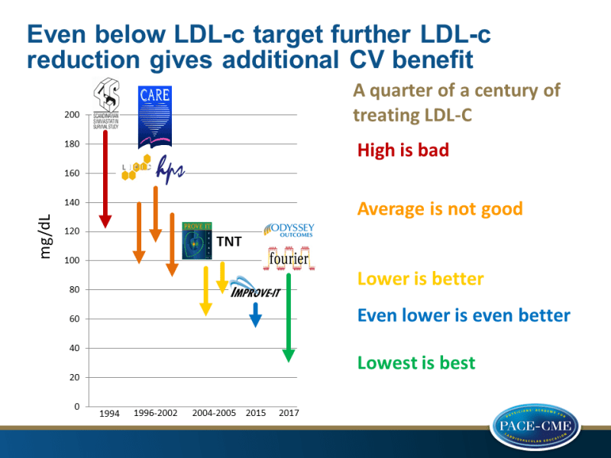
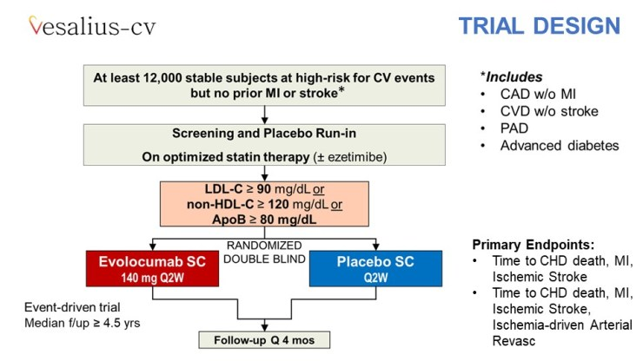
Lower LDL-C for Longer is BEST
High LDL-C is bad
Lancet. 1994;344(8934):1383-1389.
Average LDL-C is not good
N Engl J Med. 1998;339(19):1349-1357.; Circulation. 1998;98(23):2513-2519.; Lancet. 2002;360(9326):7-22.
Lower LDL-C is better
N Engl J Med. 2005;352(14):1425-1435.; J Am Coll Cardiol. 2009;54(25):2358-2362.
Even lower LDL-C is even better
N Engl J Med. 2015;372(25):2387-2397.
Lower LDL-C for longer is best
N Engl J Med. 2017;376(18):1713-1722; N Engl J Med. 2018;379(22):2097-2107.; N Engl J Med. 2026;394:117-127.

Slide 11
ASCVD Risk Assessment, Goal Setting, and Statin Intensity

Slide 12
ASCVD Risk Categories
Clinical ASCVD
Subclinical Atherosclerosis
Primary Prevention
Severe Hyper-cholesterolemia (LDL-C >190)​
Diabetes
(Type 1 or 2)
This refers to patients without ASCVD, subclinical atherosclerosis, or diabetes, and an LDL-C <190 mg/dL​
Circulation. 2026;153:e1154–e1276.

Slide 13
Principles of LDL-C Goal Setting
Based on ASCVD risk
The higher the ASCVD risk, the lower the LDL-C goal
LDL-C Goals:
Rule of 100/70/55
Circulation. 2026;153:e1154–e1276.

Slide 14
LDL-C Goals for ASCVD Risk Reduction
Patient Population​ | LDL-C < 55 mg/dL​ Non-HDL-C <85 mg/dL​ | LDL-C < 70 mg/dL​ Non-HDL-C <100 mg/dL​ | LDL-C < 100 mg /dL​ Non-HDL-C <130 mg/dL​
Clinical ASCVD​ | At very high risk​
Subclinical atherosclerosis​ | CAC ≥ 1000 AU​ Optional: CAC 300-999 AU​
Severe hypercholesterolemia (LDL-C ≥190 mg/dL)​ | With clinical ASCVD​
Diabetes mellitus (type 1 and 2)​ | N/A​
Primary prevention​ | N/A​
Circulation. 2026;153:e1154–e1276.

Slide 15
LDL-C Goals for ASCVD Risk Reduction
Patient Population​ | LDL-C < 55 mg/dL​ Non-HDL-C <85 mg/dL​ | LDL-C < 70 mg/dL​ Non-HDL-C <100 mg/dL​
Clinical ASCVD​ | At very high risk​ | NOT at very high risk​
Subclinical atherosclerosis​ | CAC ≥ 1000 AU​ Optional: CAC 300-999 AU​ | CAC 100-999 AU​ or ≥75th percentile​
Severe hypercholesterolemia (LDL-C ≥190 mg/dL)​ | With clinical ASCVD​ | With FH, ASCVD risk factors, or subclinical atherosclerosis​
Diabetes mellitus (type 1 and 2)​ | N/A​ | With ASCVD risk factors or diabetes-specific risk enhancers​
Primary prevention​ | N/A​ | PREVENT-ASCVD ≥ 10%​
Circulation. 2026;153:e1154–e1276.

Slide 16
LDL-C Goals for ASCVD Risk Reduction
Patient Population​ | LDL-C < 55 mg/dL​ Non-HDL-C <85 mg/dL​ | LDL-C < 70 mg/dL​ Non-HDL-C <100 mg/dL​ | LDL-C < 100 mg /dL​ Non-HDL-C <130 mg/dL​
Clinical ASCVD​ | At very high risk​ | NOT at very high risk​ | N/A​
Subclinical atherosclerosis​ | CAC ≥ 1000 AU​ Optional: CAC 300-999 AU​ | CAC 100-999 AU​ or ≥75th percentile​ | CAC 1-99 AU​ and <75th percentile​
Severe hypercholesterolemia (LDL-C ≥190 mg/dL)​ | With clinical ASCVD​ | With FH, ASCVD risk factors, or subclinical atherosclerosis​ | Without FH, ASCVD risk factors, and subclinical atherosclerosis​
Diabetes mellitus (type 1 and 2)​ | N/A​ | With ASCVD risk factors or diabetes-specific risk enhancers​ | Without ASCVD risk factors or diabetes-specific risk enhancers​
Primary prevention​ | N/A​ | PREVENT-ASCVD ≥ 10%​ | PREVENT-ASCVD <10%​
Circulation. 2026;153:e1154–e1276.

Slide 17
Can LDL-C Be Too Low?
Genetic Evidence
Loss-of-function mutations in APOB and PCSK9
ApoB/LDL-C levels ~10-40 mg/dL
Have a near-zero risk of ASCVD
Evolutionary Evidence
Humans did not evolve to maintain persistently high ApoB levels; rather, we evolved the metabolic machinery to produce them when needed – for energy transport, tissue repair, and immune defense.
In the modern environment, that capacity is frequently activated chronically, which contributes to persistent dyslipidemia and ASCVD.
Clinical Evidence
Long-term (>8 years) LDL-C levels of ~30 mg/dL with evolocumab + statin was associated with:
Persistently low rates of adverse events that did not exceed those observed in the original placebo arm during the parent study
Further reductions in ASCVD events
An ApoB/LDL-C level of ~10-20 mg/dL is sufficient for survival

Slide 18
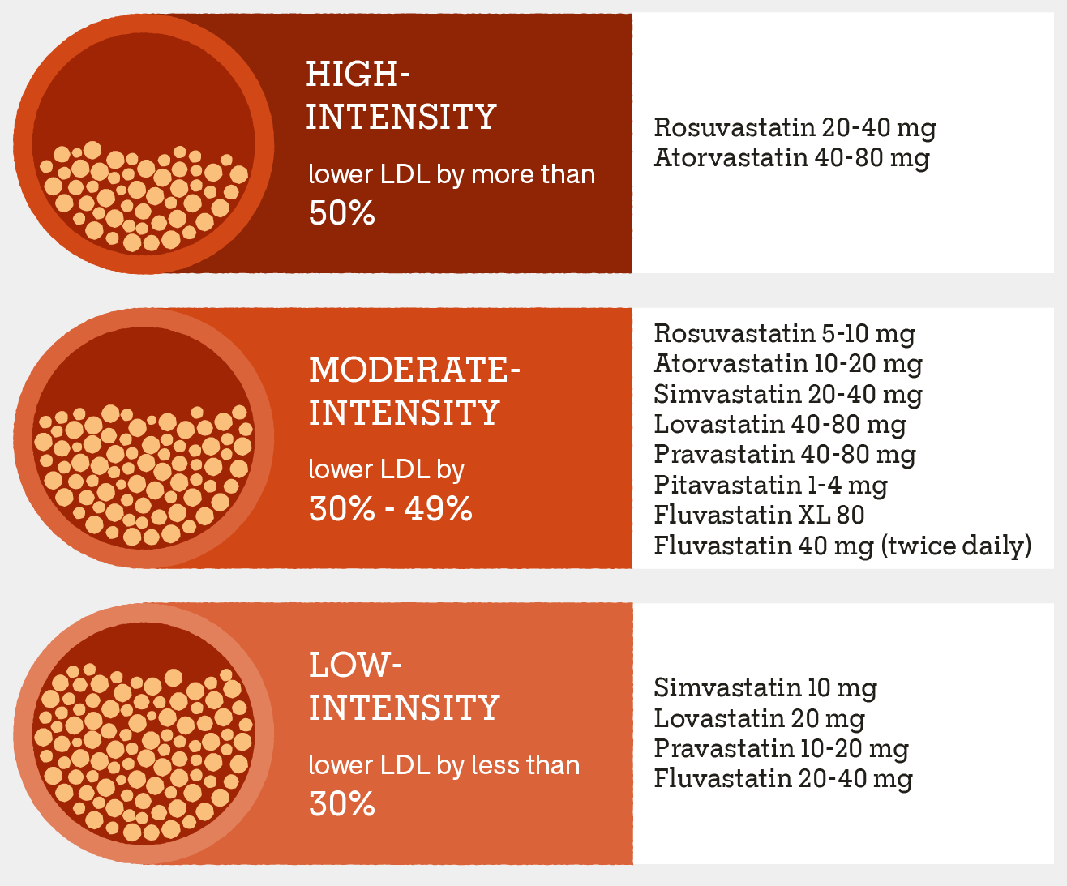
Statins are First Line for Reducing LDL-C and ASCVD Risk
Circulation. 2026;153:e1154–e1276.

Slide 19
Which Statin Intensity Do I Use?
Patient Population | HIGH Intensity Statin | MODERATE Intensity Statin
Clinical ASCVD | ✔️ | N/A
Severe hypercholesterolemia | ✔️ | N/A
Subclinical atherosclerosis | ✔️ (if CAC >100 or ≥75th percentile) | ✔️ (if CAC 1-99 and <75th percentile)
Diabetes mellitus (type 1 and 2) | ✔️ | ✔️ (ONLY if no ASCVD risk factors or diabetes-specific risk enhancers)
Primary prevention | ✔️ (if 10y ASCVD Risk >10%) | ✔️ (Consider in select patients if 10y ASCVD Risk is <10%)
Circulation. 2026;153:e1154–e1276.

Slide 20
Frequently Asked Questions: Statin Therapy
Q: Do statins really cause muscle pain?
A: Yes, statin-associated muscle symptoms are real; however, these are attributable to statin therapy in only 5-10% of cases.
  90% of these symptoms may be due to the nocebo effect
  Routine CK monitoring is not recommended, but it is reasonable to obtain a CK if rhabdomyolysis is suspected
  Co-enzyme Q10 is safe but likely not effective, so it is not recommended
Q: Do statins increase the risk of type 2 diabetes (T2DM)?
A: Yes, statins do increase the risk of T2DM; however, this is a dose-dependent effect and occurs primarily in patients already at risk for T2DM
  The benefit of statin therapy far outweighs the risk
  Statin therapy is indicated in patients with T2DM anyway, so…
J Clin Lipidol. 2023 Jan-Feb;17(1):19-39.
Circulation. 2026;153:e1154–e1276.

Slide 21
Frequently Asked Questions: Statin Therapy
Q: Can statins be used in patients with liver disease?
A: Yes, statins are SAFE and likely BENEFICIAL in patients with chronic, stable liver disease.
  Routine LFT monitoring is not recommended, although baseline LFT before starting statin therapy is still appropriate
Q: Some patients report memory loss and cognitive impairment with statin therapy. Is there any truth to this?
A: Statins are weakly associated with memory loss and cognitive impairment, but this is limited to post-marketing and anecdotal reports
  A growing body of evidence suggests that statins may actually be neuroprotective
Circulation. 2026;153:e1154–e1276.

Slide 22
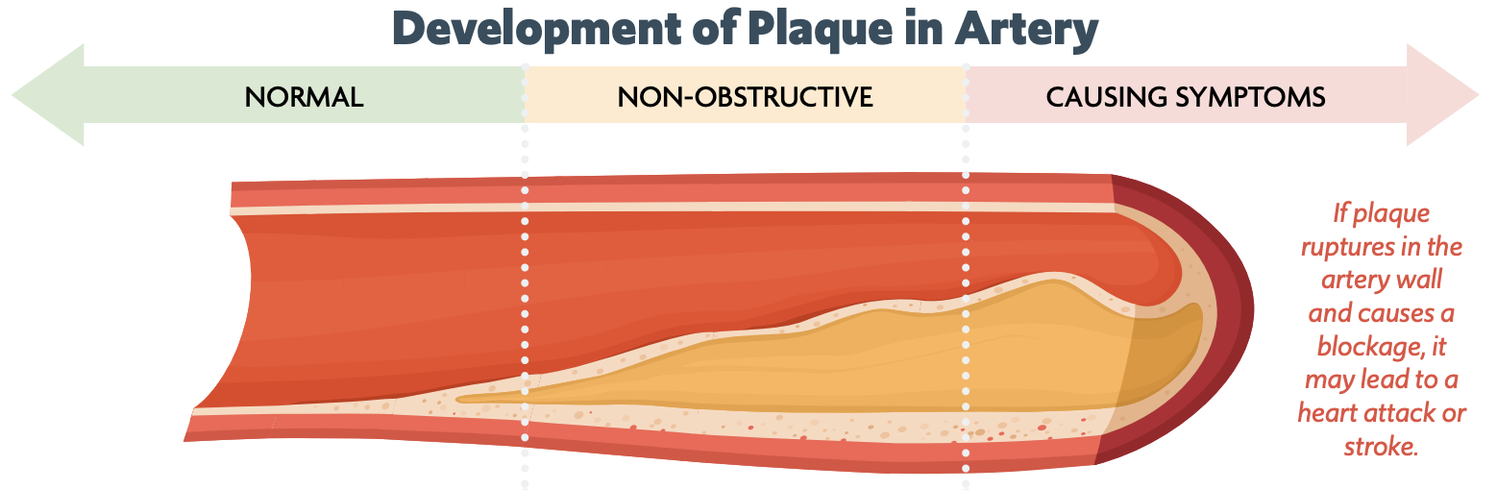
Clinical Atherosclerotic Cardiovascular Disease (ASCVD)
“Symptomatic” Atherosclerosis
Coronary heart disease (CHD), such as myocardial infarction (MI), angina, and coronary artery stenosis > 50%
Cerebrovascular disease, such as transient ischemic attack (TIA), ischemic stroke, and carotid artery stenosis > 50%.
Symptomatic peripheral artery disease (PAD), such as claudication.
Aortic atherosclerotic disease, such as abdominal aortic aneurysm (AAA) and descending thoracic aneurysm.
Circulation. 2026;153:e1154–e1276.

Slide 23
Clinical ASCVD: Very High Risk
Major ASCVD events
ACS within past 12 months
History of MI (other than ACS above)
History of ischemic stroke
Symptomatic PAD
≥2 Major ASCVD Events
OR
High Risk Conditions
Age ≥65
CABG or PCI
Current tobacco smoker
Diabetes (type 1 or 2)
Heart failure
Hypertension
LDL-C ≥ 100 despite maximally tolerated statin + ezetimibe
1 Major ASCVD Event
≥2 High Risk Conditions
+
CABG: coronary artery bypass graft surgery, PCI: percutaneous coronary intervention
Circulation. 2026;153:e1154–e1276.

Slide 24
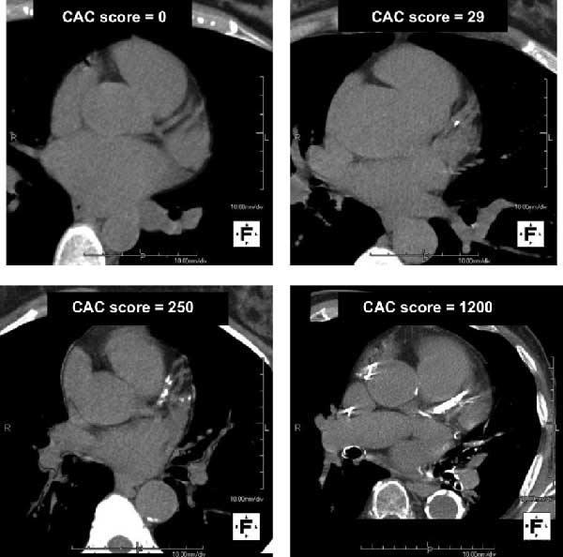
Subclinical Atherosclerosis
Subclinical atherosclerosis = asymptomatic ASCVD
  Primarily detected using CAC testing, but incidental CAC can be found on chest CT, carotid ultrasound, and coronary CT angiography (CCTA)
Ideal for primary prevention patients ≥40 years of age and a 10-year PREVENT-ASCVD risk score between 3% and 10% (borderline-intermediate risk), and in rare cases, for low-risk patients with a significant family history of ASCVD
Limitations
  Only identifies calcified plaque
  A CAC score of zero may need repeating in 3 to 7 years, and is less reliable in patients with diabetes, tobacco users, and adults under 40 years of age
Computed Tomography (CT) Scan
Measured in Agatston Units (AU)
Circulation. 2026;153:e1154–e1276.

Slide 25
Severe Hypercholesterolemia (LDL-C ≥190 mg/dL)
Primary / Genetics
  Polygenic lipid disorder: multiple small-effect gene variations with varying degrees of effect on LDL-C levels
    Most common cause of hypercholesterolemia
  Monogenic lipid disorder: one single variant impairing LDL receptor function (i.e., familial hypercholesterolemia)
    Heterozygous FH affects 1 in ~250 people
    Homozygous FH affects 1 in ~300,000 people
Secondary / Acquired
  Hypothyroidism, nephrotic syndrome, cholestatic liver disease, chronic kidney disease, ketogenic diet, medications (e.g., cyclosporin, isotretinoin, steroids)
Circulation. 2026;153:e1154–e1276.
J Clin Lipidol. 2026 Apr;20(4):708-737.

Slide 26
Diabetes Mellitus (Type 1 and 2)
Cardiovascular disease is the leading cause of death in patients with type 1 or 2 diabetes
However, risk is heterogeneous among people with diabetes, therefore, those with other ASCVD risk factors or diabetes-specific risk enhancers have lower LDL-C goals
Diabetes-Specific Risk ENHANCERS
  Long duration (≥10 years for type 2; ≥20 years for type 1)
  Albuminuria ≥30 mcg of albumin/mg creatinine
  eGFR <60 mL/min/1.73²
  Retinopathy or neuropathy
  Ankle Brachial Index (ABI) <0.9
Circulation. 2026;153:e1154–e1276.

Slide 27
Calculate-Personalize-Reclassify (CPR) Framework for Risk Evaluation in Primary Prevention
Calculate and Classify
Personalize
Reclassify and Reassess
Decide and Treat
Circulation. 2026;153:e1154–e1276.

Slide 28
PREVENT-ASCVD Risk Score
https://professional.heart.org/en/guidelines-and-statements/prevent-calculator
Uses select demographics and risk factors to predict 10-year (and 30-year) ASCVD risk in adults aged 30 to 79 years
  Replaces the ASCVD Risk Estimator Plus
However, you DO NOT need to calculate the PREVENT-ASCVD Risk Score for patients meeting any of the following criteria:
History of clinical ASCVD
Subclinical atherosclerosis
LDL-C ≥ 190 mg/dL
Diabetes (Type 1 and 2)
Circulation. 2026;153:e1154–e1276.

Slide 29
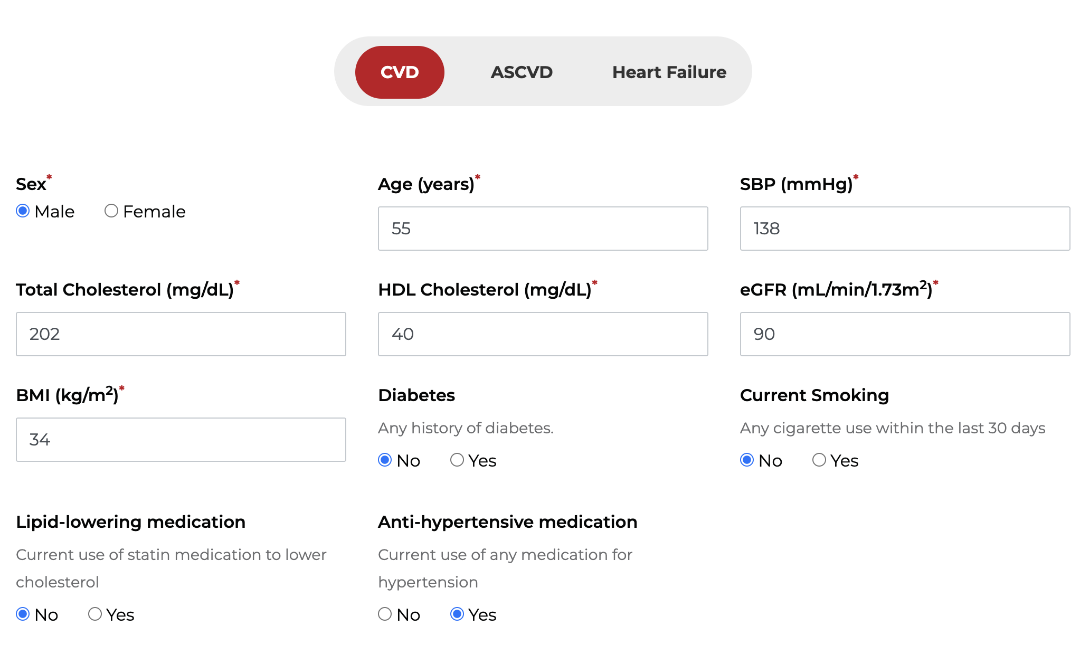
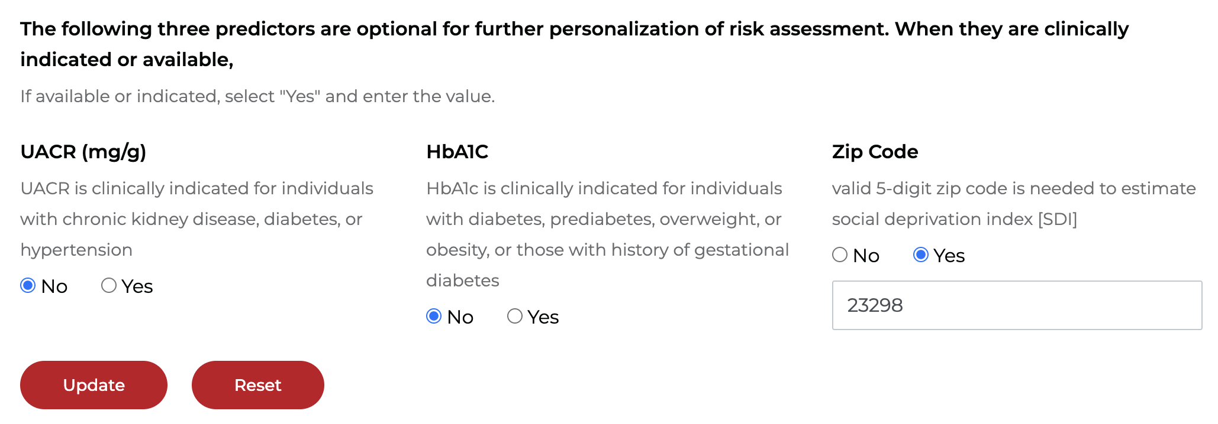
PREVENT-CVD
Calculator
In Action
Estimated 10-year risk of CVD
Estimated 10-year risk of CVD
7.6%
7.6%
Estimated 30-year risk of CVD
Estimated 30-year risk of CVD
33.9%
33.9%

Slide 30
PREVENT-ASCVD Score Interpretation
Low (0 to <3%)
Lifestyle intervention only if LDL-C <160
Borderline (3 to <5%)
Lifestyle intervention only, UNLESS ≥1 risk enhancer is present, then consider moderate-intensity statin
Intermediate (5 to <10%)
High (≥10%)
Moderate-intensity statin therapy
May consider moderate-intensity statin therapy if LDL-C ≥160
May also consider CAC testing if clinical or patient uncertainty about starting statin therapy
May also consider CAC testing if clinical or patient uncertainty about starting statin therapy
High-intensity statin therapy
Circulation. 2026;153:e1154–e1276.

Slide 31
Risk Factor vs. Risk-Enhancing Factor
Risk Factor
Risk-Enhancing Factor
  Independently and consistently predictive of risk
  Ex.) age, sex, HTN, dyslipidemia, CKD, DM, obesity, smoking
  Not independently predictive enough to anchor risk
  Used to refine risk assessment
  Full list on next slide
Circulation. 2026;153:e1154–e1276.

Slide 32
Risk-Enhancing Factors – Primary Prevention
For patients at borderline PREVENT-ASCVD risk
Risk Enhancing Factors | Description
History of premature ASCVD | Parent or sibling (onset age <55 for men; <65 for women)
High-risk ancestry | South Asian, Filipino
Chronic inflammatory conditions | psoriasis, rheumatoid arthritis, lupus
Primary hypercholesterolemia | LDL-C persistently 160-189 mg/dL
Elevated Lipoprotein(a) | ≥ 125 nmol/L or ≥ 50 mg/dL
Elevated hs-CRP | ≥ 2 mg/L on more than one occasion
Elevated triglycerides | TG persistently ≥175 mg/dL (non-fasting) or ≥150 mg/dL (fasting)
Metabolic syndrome | Need ≥3 of these: Elevated waist circumference, TG >175 mg/dL, BP >130/80, HDL-C <40 mg/dL, impaired fasting glucose
Chronic kidney disease | eGFR 15-59 mL/min/1.73m² (but no dialysis or kidney transplant)
Reproductive risk markers | Menopause onset before age 45, pre-eclampsia, gestational diabetes, gestational hypertension, pre-term delivery
Circulation. 2026;153:e1154–e1276.

Slide 33
Lipid Measurement Controversy
LDL-C
Non-HDL-C
ApoB

Slide 34
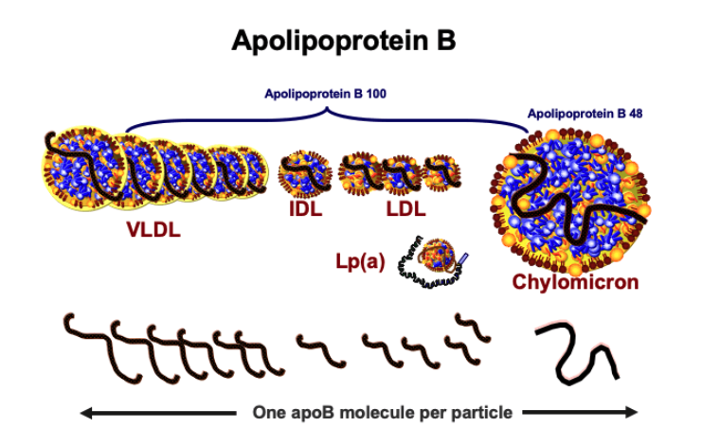
ApoB Particles Drive ASCVD Risk
“Trapping of apoB lipoprotein particles within the arterial wall is the fundamental step that initiates and drives the atherosclerotic process from beginning to end…”
JAMA Cardiol. 2019 Dec 1;4(12):1287-1295.

Slide 35
Which Patient is at Higher Risk?
Lower particle number
LDL
Higher particle number
Cholesterol
Common in patients with obesity, diabetes, metabolic syndrome
Same
LDL-C
Level
Patient A
Patient B
JAMA Cardiol. 2019 Dec 1;4(12):1287-1295.

Slide 36
Comparison of Lipid Measurements
LDL-C
  A calculated estimate of the cholesterol content carried by LDL, which is falsely lower when TG/VLDL levels are elevated
  Does not include cholesterol-depleted lipoproteins
  Most familiar to clinicians and used in nearly all lipid-lowering therapy trials
Non-HDL-C
  A calculated estimate (TC minus HDL-C) of the cholesterol content carried by all apoB particles; however, it still doesn’t account for cholesterol-depleted lipoproteins
ApoB
  A direct measurement of the total number of apoB particles
  Most accurate but less familiar to clinicians, and not the surrogate marker used in clinical trials
Circulation. 2026;153:e1154–e1276.

Slide 37
Guideline Recommendations on Lipid Testing
Nonfasting or fasting lipid profile is recommended to document baseline lipid levels, estimate ASCVD risk, and guide initiation of lipid-lowering therapy.
  Fasting lipid profile is recommended in patients with TG levels >400 mg/dL
  Non-HDL-C is useful in patients with HTG
The Martin/Hopkins or Sampson/NIH equations are preferred over the Friedewald equation to estimate LDL-C
Advanced lipoprotein testing to assess lipoprotein subclasses, LDL particle size, etc., is NOT RECOMMENDED
ApoB testing is reasonable in adults with ASCVD, CKM, diabetes, and/or HTG once LDL-C and/or non-HDL-C goals are achieved
Circulation. 2026;153:e1154–e1276.

Slide 38
Follow up
When to check the lipid profile:
4 to 12 weeks after initiation or dose adjustment
Once the LDL-C goal is achieved, every 6 to 12 months to assess efficacy and adherence
Circulation. 2026;153:e1154–e1276.

Slide 39
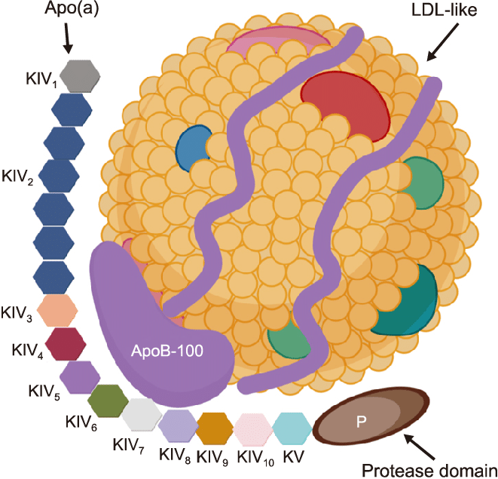
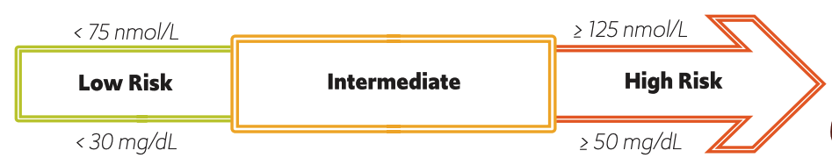
Lipoprotein(a)
A mostly inherited, causal risk factor for ASCVD and calcific aortic valve disease INDEPENDENT of LDL-C levels
Guidelines now recommend measuring Lp(a) at least once in every adult’s lifetime (nmol/L is preferred)
Useful “risk-enhancing factor” that helps further stratify an individual’s risk of ASCVD
Circulation. 2026;153:e1154–e1276.

Slide 40
Role of Non-Statin Therapy to Reduce LDL-C and ASCVD Risk

Slide 41
Comparison of LDL-C Lowering Non-Statins
LDL-C Lowering Classes | Administration | LDL-C Reduction | ASCVD Event Reduction Evidence
Bempedoic acid Bempedoic acid/ezetimibe | 180 mg PO BID 180/10 mg PO BID | 15 to 25% up to 40% | Yes (+) Not as a combination
Ezetimibe Bile acid sequestrants | 10 mg PO QD Variable | 15 to 25% 15 to 25% | Yes (+) Monotherapy only
Alirocumab | 75-150 mg SC q2w (or 300 mg SC monthly) | 50 to 60% | Yes (+)
Evolocumab | 75-150 mg SC q2w (or 300 mg SC monthly) | 50 to 60% | Yes (+)
*Inclisiran | 284 mg SC x1, day 90, then q6 months | 40 to 50% | Pending
Lerodalcibep | 300 mg SC monthly | 50 to 60% | Pending
*Must be administered by a healthcare professional
Circulation. 2026;153:e1154–e1276.

Slide 42
Not Recommended for ASCVD Risk Reduction Due to Lack of Benefit
Dietary Supplements
Niacin
Fibrates
Circulation. 2026;153:e1154–e1276.

Slide 43
Management of High Triglycerides

Slide 44
What do elevated triglycerides tell us?
Metabolically speaking, elevated TG levels signal impaired handling of TG-rich lipoproteins and disordered energy trafficking (i.e., VLDL overproduction and/or impaired clearance), and insulin resistance
Elevated TG levels are strongly associated with:
  Metabolic syndrome
  Central adiposity
  Metabolic dysfunction-associated steatotic liver disease (MASLD)
  Diabetes
  Pre-diabetes
Elevated TG levels indicate an elevated apoB particle number, small dense LDL phenotype, and low HDL-C
  This does mean increased ASCVD risk, but it’s due to the elevated apoB particle number and small dense LDL phenotype rather than the elevated TG levels, alone
Circulation. 2026;153:e1154–e1276.

Slide 45
STEP 1
Evaluate and Address Secondary Causes
Diseases
  Diabetes, chronic kidney disease, hypothyroidism
Diet/lifestyle
  Alcohol, a diet high in added sugars and saturated fat, a sedentary lifestyle, and total parenteral nutrition
Genetics
  Deficiency of lipoprotein lipase (LPL) or apolipoprotein C-II (apo-CII)
Medications
  propofol, beta blockers, diuretics, bile acid sequestrants, steroids, estrogens, isotretinoin, atypical antipsychotics, immunosuppressive agents
Metabolism disorders
  overweight and obesity, metabolic syndrome, pregnancy (third trimester)
Circulation. 2026;153:e1154–e1276.

Slide 46
Moderate Hypertriglyceridemia (150 to 499 mg/dL)
Assess ASCVD risk and initiate statin therapy if indicated to lower ASCVD risk
It is also reasonable to add icosapent ethyl (Vascepa®) in patients with clinical ASCVD or diabetes, and an LDL-C <100 on statin therapy, to lower ASCVD risk
STEP 2
Pharma-cological Intervention
Circulation. 2026;153:e1154–e1276.

Slide 47
Severe Hypertriglyceridemia (≥500 mg/dL; especially if ≥1000)
If statin therapy is indicated, initiate statin therapy
Initiate fenofibrate and/or prescription O3FA (2-4 g/d)
Gemfibrozil may be considered only if the patient is not on statin therapy, although fenofibrate is still preferred since it’s once daily and better tolerated
Only consider niacin when all of the above options are not tolerated or contraindicated
STEP 3
Pharma-cological Intervention
Circulation. 2026;153:e1154–e1276.

Slide 48
HDL Cholesterol: More Questions than Answers
Low HDL-C is a consistent epidemiologic predictor of ASCVD risk; however, HDL is a structurally and functionally complex lipoprotein and simply measuring its cholesterol concentration does not fully capture its biologic activity.
Multiple randomized trials have failed to show that raising HDL-C (with niacin and CETP inhibitors) reduces ASCVD risk
Recommendations to Address Low HDL-C:
Avoid tobacco
Increase aerobic exercise
Maintain a healthy weight
Avoid diabetes
Niacin
Torcetrapib
Anacetrapib
Dalcetrapib
Evacetrapib
Circulation. 2026;153:e1154–e1276.

Slide 49
Patient Case Scenario
AMJ is a 58 yo man is screened for dyslipidemia. He has no prior evidence of ASCVD. His PMH includes HTN, pre-diabetes, obesity, and metabolic syndrome. He quit tobacco 3 years ago. He is currently taking losartan/HCTZ 100/25 mg daily and metformin XR 500 mg twice daily.
10-year PREVENT-ASCVD = 8.4%
TC 238
LDL-C 151
HDL-C 36
TG 242
non-HDL-C 202
A1c 6.1%

Slide 50
Patient Case Scenario
AMJ is a 58 yo man is screened for dyslipidemia. He has no prior evidence of ASCVD. His PMH includes HTN, pre-diabetes, obesity, and metabolic syndrome. He quit tobacco 3 years ago. He is currently taking losartan/HCTZ 100/25 mg daily and metformin XR 500 mg twice daily.
10-year PREVENT-ASCVD = 8.4%
TC 238
LDL-C 151
HDL-C 36
TG 242
non-HDL-C 202
A1c 6.1%
He is reluctant to take statin therapy due to uncertainty about the benefits and risks. Which of the following would be most helpful?
  A. apoB​
  B. hs-CRP testing​
  C. Creatine kinase ​
  D. Coronary artery calcium testing

Slide 51
Patient Case Scenario
AMJ is a 58 yo man is screened for dyslipidemia. He has no prior evidence of ASCVD. His PMH includes HTN, pre-diabetes, obesity, and metabolic syndrome. He quit tobacco 3 years ago. He is currently taking losartan/HCTZ 100/25 mg daily and metformin XR 500 mg twice daily.
10-year PREVENT-ASCVD = 8.4%
TC 238
LDL-C 151
HDL-C 36
TG 242
non-HDL-C 202
A1c 6.1%
CAC 176, 81st percentile
He is reluctant to take statin therapy due to uncertainty about the benefits and risks. Which of the following would be most helpful?
  A. apoB​
  B. hs-CRP testing​
  C. Creatine kinase ​
  D. Coronary artery calcium testing
What is his LDL-C goal?
​
  A. < 55 mg/dL
  B. < 70 mg/dL
  C. < 100 mg/dL
  D. < 130 mg/dL

Slide 52
Patient Case Scenario
AMJ is a 58 yo man is screened for dyslipidemia. He has no prior evidence of ASCVD. His PMH includes HTN, pre-diabetes, obesity, and metabolic syndrome. He quit tobacco 3 years ago. He is currently taking losartan/HCTZ 100/25 mg daily and metformin XR 500 mg twice daily.
10-year PREVENT-ASCVD = 8.4%
TC 238
LDL-C 151
HDL-C 36
TG 242
non-HDL-C 202
A1c 6.1%
CAC 176, 81st percentile
He is reluctant to take statin therapy due to uncertainty about the benefits and risks. Which of the following would be most helpful?
  A. apoB​
  B. hs-CRP testing​
  C. Creatine kinase ​
  D. Coronary artery calcium testing
What is the most appropriate initial
pharmacotherapy?​
​
  Rosuvastatin 10 mg​
  Pravastatin 20 mg​
  Atorvastatin 40 mg​
  Lovastatin 20 mg

Slide 53
Key Updates: 2026 Dyslipidemia Guideline​
Earlier treatment to reduce lifelong exposure to atherogenic lipoproteins and lower ASCVD risk​
PREVENT-ASCVD replaces the ASCVD Risk Estimator to guide lipid-lowering therapy in primary prevention.​
Increased role of coronary artery calcium (CAC) testing to detect subclinical atherosclerosis.​
Goals of therapy for LDL-C and non-HDL-C are back to guide lipid lowering management, and guidance is provided on when to consider apoB testing.​
Lp(a) should be measured at least once in every adult's lifetime.​
Clarity on the role of select non-statins to reduce ASCVD risk.​

Slide 54
Take Home Points
LDL-C is a primary cause of atherosclerotic cardiovascular disease
Statin therapy is the first-line pharmacological treatment to lower LDL-C and reduce ASCVD risk
Select non-statins may be used with maximally tolerated statin therapy to reduce ASCVD risk further
  RCT evidence available: ezetimibe, bempedoic acid, PCSK9 mAbs, icosapent ethyl
  RCT evidence pending: inclisiran, lerodalcibep
  Do NOT reduce ASCVD risk: niacin, fibrates, dietary supplements
Elevated TG levels are primarily managed with lifestyle modifications, addressing underlying causes, statin therapy, and in select patients, fenofibrate or prescription omega-3 fatty acids
Low HDL-C is NOT a therapeutic target

