Slide 1
Overview of the 2025
AHA/ACC Guidelines on High Blood Pressure
Dave L. Dixon, PharmD, FACC, FAHA, FCCP, FNLA, BCACP, CLS

Slide 2

HeartBeat California Program

Slide 3
Today’s Agenda
Introduction
Significance and Prevalence of Hypertension
Diagnosis of Hypertension
Treatment Goals
Management of High Blood Pressure
Patient Case Scenarios
Q&A

Slide 4
How to Claim Your CME
Use access link + code sent by email after the session ​
Enroll in the course using the link ​
Enter access code to unlock content ​
Complete knowledge checks and evaluation ​
Claim credit and download certificate​

Slide 5

Dave L. Dixon
PharmD, FACC, FAHA, FCCP, FNLA, BCACP, CLS
Nancy and Ronald McFarlane Professor of Pharmacy; Chair, Department of Pharmacotherapy & Outcomes Science Virginia Commonwealth University School of Pharmacy; Professor, Department of Internal Medicine (Division of Cardiology), Virginia Commonwealth University School of Medicine

Slide 6
Learning Objectives
1
Describe the prevalence, significance, and contemporary diagnostic approaches to hypertension.
Define treatment goals for adults with hypertension and discuss current and emerging antihypertensive pharmacotherapy.
Apply current clinical practice guidelines to patient scenarios within a team-based framework.
2
3

Slide 7
Commonly Used Acronyms
ABPM | Ambulatory Blood Pressure Monitoring
ACEi | Angiotensin-Converting Enzyme Inhibitors
ARB | Angiotensin II Receptor Blockers
CKD | Chronic Kidney Disease
CVD | Cardiovascular Disease
DBP | Diastolic Blood Pressure
HBPM | Home Blood Pressure Monitoring
HTN | Hypertension
MRA | Mineralocorticoid Receptor Antagonist
SBP | Systolic Blood Pressure
SPC | Single Pill Combination

Slide 8

Significance of Hypertension
Largely an asymptomatic disease that adversely affects heart, kidney, and brain health
Primary or contributing cause of over 660,000 deaths in 2023
Leading modifiable metabolic risk factor for cardiovascular disease and all-cause mortality
Vaduganathan M, et al. J Am Coll Cardiol. 2022;80(25):2361-2371.; Jones DW, et al. Hypertension. 2025;82(10):e212-e316.; Centers for Disease Control and Prevention.

Slide 9

Prevalence of Hypertension in the US
Affects nearly 50% of US adults
Earlier onset and slightly higher prevalence among men compared to women
Disproportionately affects non-Hispanic Blacks compared to other racial and ethnic groups
Jones DW, et al. Hypertension. 2025;82(10):e212-e316;
Image Source: Microsoft PowerPoint Stock Images

Slide 10
Reducing BP Reduces Risk
BP reduction to reduce CVD risk is supported by observational data, clinical trials, and meta-analyses
  ~10% RRR for every 5 mm Hg SBP lowering
  Benefit is similar among those with and without CVD
BP reduction to reduce dementia risk is supported by clinical trials and meta-analyses
  12% to 19% reduction in dementia incidence
  Dementia risk decreases with only 3-4 years of intensive blood pressure treatment
RRR: relative risk reduction
Jones DW, et al. Hypertension. 2025;82(10):e212-e316.

Slide 11
Diagnosis of Hypertension

Slide 12
Blood Pressure Categories (since 2017)
Category | Systolic BP, mm Hg | Qualifier | Diastolic BP, mm Hg
Normal | LESS THAN 120 | AND | LESS THAN 80
Elevated | 120 – 129 | AND | LESS THAN 80
Stage 1 Hypertension | 130 – 139 | OR | 80 – 89
Stage 2 Hypertension | 140 OR HIGHER | OR | 90 OR HIGHER
Hypertensive Emergency | HIGHER THAN 180 | AND/OR | HIGHER THAN 120
NOTE: Hypertension during pregnancy is defined as
≥140 mm Hg AND/OR ≥90 mm Hg
Jones DW, et al. Hypertension. 2025;82(10):e212-e316.

Slide 13
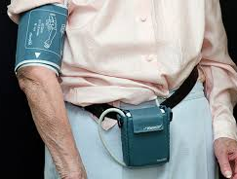
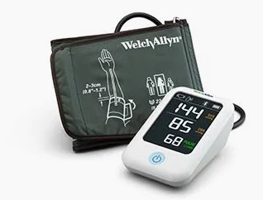
Hypertension Diagnosis
Out-of-office BP measurements obtained by either 24-hour ABPM or HBPM are recommended to confirm a hypertension diagnosis
  Cuffless BP devices are NOT recommended
HBPM Protocol
  2 readings 1 minute part twice a day for 3-7 days
24-hour ABPM
HBPM
Jones DW, et al. Hypertension. 2025;82(10):e212-e316.

Slide 14
Blood Pressure Phenotypes Based on Office and Out-of-Office BP Measurements
Blood Pressure Category | High Office BP | High Out-of-Office BP | High Out-of-Office BP
Among individuals NOT taking antihypertensive medications
Sustained normotension | No | No | No
Sustained hypertension | Yes | Yes | Yes
Masked hypertension | No | Yes | Yes
White-coat hypertension | Yes | No | No
Among individuals TAKING antihypertensive medications
Controlled hypertension | No | No
Uncontrolled hypertension | Yes | Yes
Masked uncontrolled hypertension | No | Yes
White-coat effect | Yes | No
Jones DW, et al. Hypertension. 2025;82(10):e212-e316.

Slide 15
Secondary Forms of Hypertension
Common Causes
Uncommon Causes
Obstructive sleep apnea
Chronic kidney disease
Primary aldosteronism
Drug or alcohol induced
Renovascular hypertension
Hypothyroidism
Hyperthyroidism
Pheochromocytoma/ paraganglioma
Aortic coarctation
Cushing syndrome
Primary hyperparathyroidism
Congenital adrenal hyperplasia
Acromegaly
Jones DW, et al. Hypertension. 2025;82(10):e212-e316.

Slide 16
Primary Aldosteronism Screening
New recommendations strongly recommend screening for primary aldosteronism, whether hypokalemia is present or not
It is okay to continue antihypertensives (except MRA) prior to initial screening to minimize barriers or delays in screening
Stop MRA 4 weeks before testing
Positive screening typically includes:
Renin <1 ng/mL/h
Aldosterone >10 ng/dL
Aldosterone:renin >20
Jones DW, et al. Hypertension. 2025;82(10):e212-e316.
MRA: mineralocorticoid antagonist

Slide 17
Treatment Goals for Individuals with Hypertension

Slide 18
Blood Pressure Goals
SBP goal of at least <130 mm Hg
<120 mm Hg is encouraged
DBP goal of at least <80 mm Hg
Jones DW, et al. Hypertension. 2025;82(10):e212-e316.

Slide 19
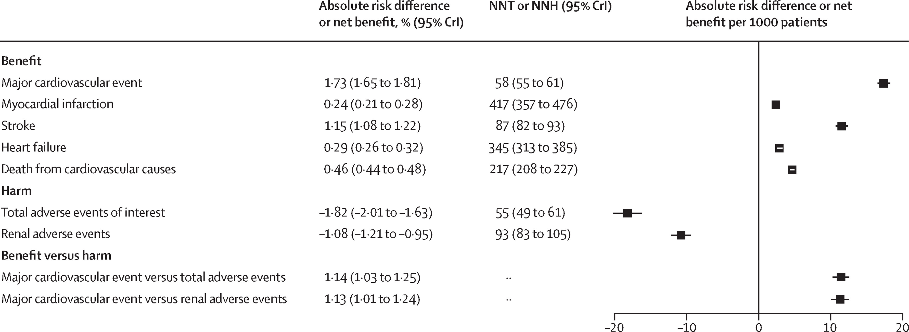
Lower BP Goals are Safe and Effective
Multiple randomized clinical trials representing >80,000 participants have compared intensive vs. standard BP goals
  ACCORD BP, SPRINT, ESPIRIT, BPROAD, STEP, CRHCP
The Lancet, 2025; 406, 1009-1019

Slide 20
Hypertension and Cognitive Health
Class IA: In adults with hypertension, a goal of <130 mm Hg SBP is recommended to prevent mild cognitive impairment or dementia.
Jones DW, et al. Hypertension. 2025;82(10):e212-e316.

Slide 21
Blood Pressure Control in the US
Only 1 in 4 adults with HTN are controlled, defined as <130/80 mmHg
Nearly half with uncontrolled HTN have a BP ≥140/90 mmHg
CDC. https://www.cdc.gov/high-blood-pressure/data-research/facts-stats/index.html.
Published January 28, 2025. Accessed November 13, 2025.

Slide 22
Factors in Favor of and Against BP Control
Factors Favoring BP Control | Factors Against BP Control
Availability of inexpensive, generic, fixed-dose combination medications | Asymptomatic disease leading to low perceived urgency to manage BP
Robust evidence base that lowering BP reduces the risk of adverse outcomes | Majority of individuals will require multiple medications to control their BP
General public understanding of hypertension is higher than with other conditions | Social determinants of health (e.g., food insecurity, safe space for exercise)
BP is easily measured and various technologies and tools exist to support patients and clinicians | Therapeutic inertia (i.e., lack of therapy intensification when BP is uncontrolled)
Jones DW, et al. Hypertension. 2025;82(10):e212-e316.
Dixon DL, et al. J Am Coll Cardiol. 2019;74(13):1728-1731.

Slide 23
Management of High Blood Pressure

Slide 24
PREVENT-CVD Calculator
Replaces the ASCVD Risk Estimator Plus
Incorporates risk associated with cardio-kidney-metabolic disease
Based on more contemporary observational evidence
Improved accuracy
Key Changes
Output expanded to overall risk of CVD, ASCVD only, or HF only
Lower age limit for 10-year risk estimation (30 instead of 40)
Removed race/ethnicity because it's not a biological cause of disease
Added body mass index and kidney function
Optional inputs: UACR, hemoglobin A1c, zip code

Slide 25
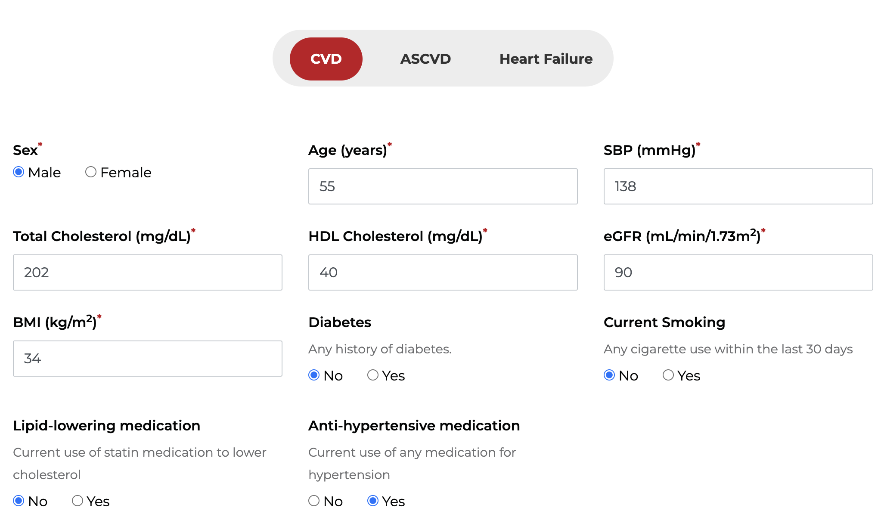
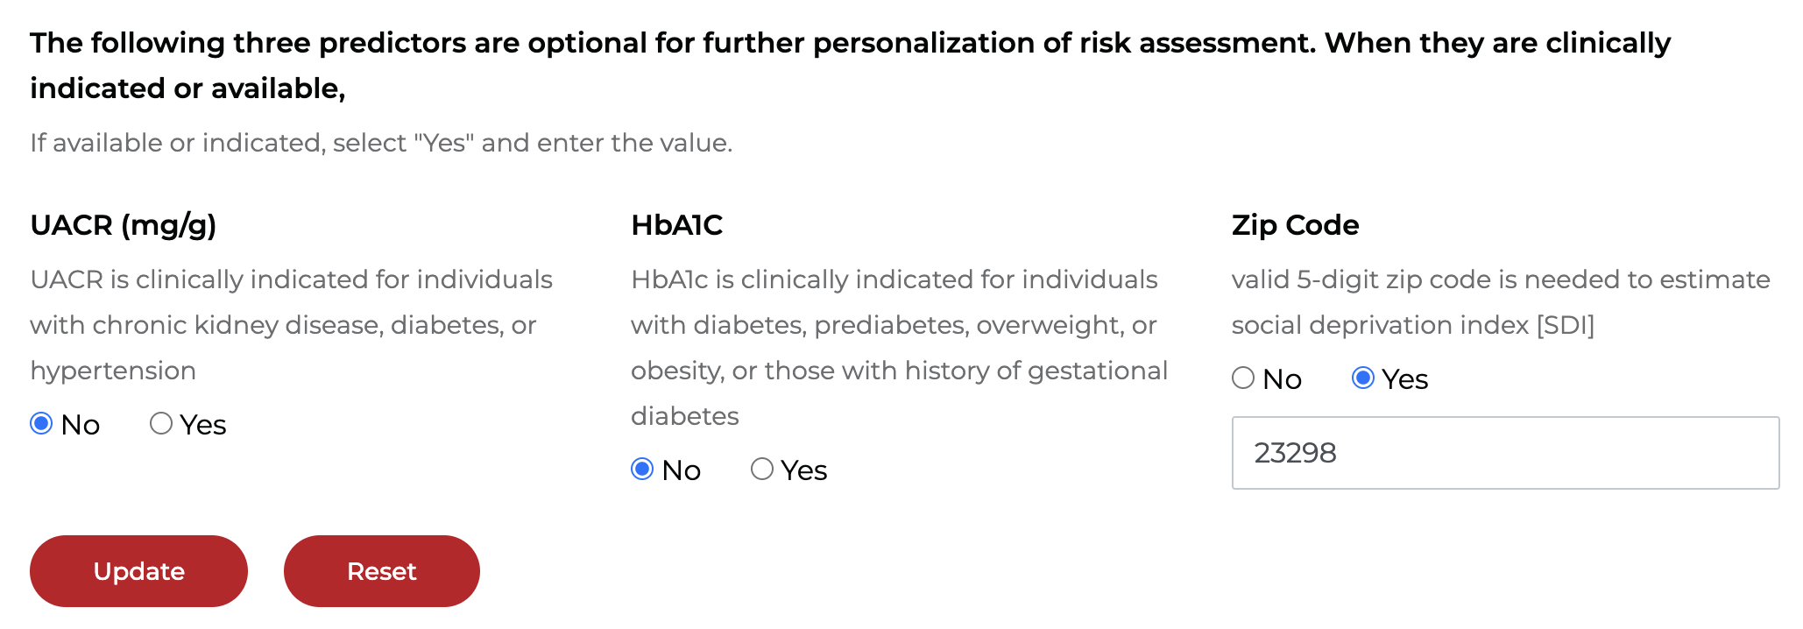
PREVENT-CVD
Calculator
In Action
Estimated 10-year risk of CVD
7.6%
Estimated 30-year risk of CVD
33.9%
American Heart Association. (n.d.). PREVENT™ calculator.
Notes:
https://professional.heart.org/en/guidelines-and-statements/prevent-calculator

Slide 26
Lifestyle and Psychosocial Approaches to Lowering Blood Pressure
Weight Loss
Low Sodium Diet
Potassium-based Salt Substitutes
Reducing or abstaining from alcohol
Increase physical activity
Stress reduction
Jones DW, et al. Hypertension. 2025;82(10):e212-e316.

Slide 27
Initial Antihypertensive Selection
A single, first-line agent should be initiated for most adults with HTN and a BP <140/90
  Thiazide-type diuretics
  Long-acting DHP calcium channel blockers
  ACE inhibitors or ARBs
Two first-line agents should be initiated in adults with stage 2 HTN (≥140/90), ideally in a single-pill combination
Jones DW, et al. Hypertension. 2025;82(10):e212-e316.

Slide 28
Selected Revised & New Recommendations
In adults with hypertension without clinical CVD and with an estimated 10-year CVD risk <7.5% based on PREVENT, initiation of medications to lower BP is recommended if average SBP remains ≥130 mm Hg or average DBP remains ≥80 mm Hg after a 3- to 6-month trial of lifestyle intervention to prevent target organ damage and mitigate further increases in BP. (COR 1)
  Changed from a 10-year ASCVD risk <10% and an SBP ≥140 mm Hg or a DBP ≥90 mm Hg

Slide 29
Selected Revised & New Recommendations
In adults with HTN, a goal of <130 mm Hg SBP is recommended to prevent mild cognitive impairment and dementia
  Changed from COR 2a (moderate) to COR 1 (strong) recommendation
In adults with resistant HTN, screen for primary aldosteronism and to continue antihypertensives (except MRAs) prior to screening – COR 1 (strong)
  New recommendation
Jones DW, et al. Hypertension. 2025;82(10):e212-e316.

Slide 30
Antihypertensive Medication Optimization: Comparison of Thiazide-Type Diuretics
Hydrochlorothiazide
Chlorthalidone
Indapamide
Short half-life
Many SPC available
Generally, well tolerated
Very familiar to majority of clinicians
More potent; very long half-life
Used in several clinical outcome trials
Greater risk for adverse effects
Limited SPC available
Middle-ground for potency, half-life, tolerability
Used in several clinical outcome trials
No SPC available
Arguably less familiar to clinicians
Jones DW, et al. Hypertension. 2025;82(10):e212-e316.

Slide 31
Antihypertensive Medication Optimization: Comparison of ACE Inhibitors
Lipophilicity
Renal Clearance
Other Considerations
Ramipril and perindopril are more lipophilic
Possibly better vascular/tissue effects
Modest clinical significance
Most ACEi are renally cleared
Exception (partial hepatic metabolism)
  fosinopril
Lisinopril is simple, cheap, once daily, widely used
Ramipril has strong outcomes data, good for high-risk patients
Perindopril provides smooth 24-hour control
Enalapril and captopril require multiple daily dosing
Jones DW, et al. Hypertension. 2025;82(10):e212-e316.

Slide 32
Antihypertensive Medication Optimization: Comparison of ARBs
BP-Lowering Potency
Comorbidities
Best: azilsartan, olmesartan, telmisartan, candesartan
Moderate: valsartan, irbesartan
Least: losartan
Losartan is uricosuric, so useful in gout
Valsartan and candesartan have the most robust HF data
Telmisartan is a partial PPAR-y agonist and modestly improves insulin sensitivity
Jones DW, et al. Hypertension. 2025;82(10):e212-e316.

Slide 33
Antihypertensive Medication Optimization: Comparison of Calcium Channel Blockers (CCB)
DHP CCB
Non-DHP CCB
Amlodipine, Felodipine, Nifedipine
Act on vascular smooth muscle (vasodilation)
Reflex tachycardia and lower extremity edema can occur
Antianginal effect; no benefit in patients with heart failure
Verapamil, Diltiazem
Greater effect on cardiac myocytes and conduction tissue (negative inotrope) ➔ reduces heart rate
  Avoid if EF <40%
Moderate inhibitor of CYP3A4
DHP: dihydropyridine; EF: ejection fraction
Jones DW, et al. Hypertension. 2025;82(10):e212-e316.

Slide 34
Evidence-Based Strategies for Improving Antihypertensive Medication Adherence
Dose consolidation
Once daily rather than multiple times daily
Use of single-pill combinations (SPC) to reduce pill burden
Use of medication reminder aids and educational or management interventions
Electronic/home blood pressure monitoring and feedback
Medication synchronization
Mindfulness-based stress reduction or counseling for high stress, anxiety, and/or depression
Jones DW, et al. Hypertension. 2025;82(10):e212-e316.

Slide 35
Definition of Resistant Hypertension
Confirm treatment resistance with 1 of the following:
  Office BP >130/80 and on >3 antihypertensives
OR
  Office BP <130/80 but requires >4 antihypertensives
  Preferred regimen:
  Combination of ACEi or ARB + CCB + thiazide-like diuretic
Jones DW, et al. Hypertension. 2025;82(10):e212-e316.

Slide 36
Management of Resistant Hypertension:
Non-Pharmacological Treatment
Exclude pseudoresistance
  Ensure accurate BP measurements
  Assess medication adherence
  Obtain home, work, or ambulatory BP readings to exclude white-coat effect
Identify and reverse contributing lifestyle factors
Discontinue or minimize interfering substances
Screen for secondary causes of hypertension
Jones DW, et al. Hypertension. 2025;82(10):e212-e316.

Slide 37
Management of Resistant Hypertension: Pharmacological Treatment
Replace HCTZ with chlorthalidone or indapamide
Add spironolactone or eplerenone if eGFR >45
Use chlorthalidone or loop diuretics in patients with CKD stage >4
Add agents with different mechanism
  BB, central sympatholytic drugs, or non-DHP CCP for elevated heart rate
Add potent vasodilators
  Aprocitentan, hydralazine, or minoxidil if already on BB and loop diuretic
In carefully selected patients with resistant hypertension despite optimal treatment, renal denervation may be reasonable.
Jones DW, et al. Hypertension. 2025;82(10):e212-e316.

Slide 38
Management of Orthostatic Hypotension (OH)
Sudden drop in BP occurring when rising from a sitting or lying to standing
  ≥20 mm Hg decrease in SBP or a ≥10 mm Hg decrease in DBP within 3 minutes of standing
  Usually symptomatic: dizziness, lightheadedness, blurred vision
  Other causes: dehydration, neurological, medication side effects
Affects 7-10% of community-dwelling adults, especially older adults, and is predictive of adverse health outcomes, INCLUDING cardiovascular disease events.
Jones DW, et al. Hypertension. 2025;82(10):e212-e316.

Slide 39
Management of Orthostatic Hypotension (OH)
RCT evidence demonstrates no association between OH and intensive BP treatment using first-line medication classes
  In adults with hypertension, improved BP control is recommended to reduce the risk for OH. (COR 1 / LOE A)
Improving BP, improves vascular physiology and autonomic responsiveness.
Management
  Hydration
  Rising slowly from bed or a chair
  Avoid long periods of standing still
  Consider compression stockings
  Use long-acting antihypertensives
  Consider nighttime dosing
Medications to avoid
  Alpha-blockers
  Central alpha-2 agonists
  Diuretics
Jones DW, et al. Hypertension. 2025;82(10):e212-e316.

Slide 40
Hypertension in Pregnancy
SBP >160 or DBP >110 confirmed by two measurements within 15 minutes should receive medication to lower BP within 30-60 minutes
Chronic hypertension in pregnancy
  Pre-pregnancy SBP 140-159 or DBP 90-109 prior to 20 weeks' gestation
  Start treatment to achieve BP <140/90
  Drugs of choice: labetalol, extended-release nifedipine
  Drugs to AVOID: ACEi, ARB, atenolol, aliskiren, nitroprusside, MRA
Jones DW, et al. Hypertension. 2025;82(10):e212-e316.

Slide 41
Patient Case Scenario
A 45 yo man presents for an annual primary care check up. His BP last year was 126/72 mm Hg and today it is 134/78 mm Hg. His only medical history is seasonal allergies for which he takes fexofenadine 180 mg daily.

Slide 42
Patient Case Scenario
A 45 yo man presents for an annual primary care check up. His BP last year was 126/72 mm Hg and today it is 134/78 mm Hg. His only medical history is seasonal allergies for which he takes fexofenadine 180 mg daily.
Which blood pressure category does he fit into?
  A. Normal
  B. Elevated
  C. Stage 1 hypertension
  D. Stage 2 hypertension

Slide 43
Patient Case Scenario
A 45 yo man presents for an annual primary care check up. His BP last year was 126/72 mm Hg and today it is 134/78 mm Hg. His only medical history is seasonal allergies for which he takes fexofenadine 180 mg daily.
What is the best next step?
  A. Provided education and counseling only.
  B. Recommend out-of-office BP monitoring.
  C. Initiate a single antihypertensive therapy.
  D. Initiate two antihypertensives.

Slide 44
Patient Case Scenario
A 45 yo man presents for an annual primary care check up. His BP last year was 126/72 mm Hg and today it is 134/78 mm Hg. His only medical history is seasonal allergies for which he takes fexofenadine 180 mg daily.
His 7-day home BP average is 136/74 mm Hg. What is the best next step?
  A. Provided education and counseling only.
  B. Calculate his 10-year PREVENT-CVD score.
  C. Initiate a single antihypertensive therapy.
  D. Initiate two antihypertensives.

Slide 45
Patient Case Scenario
A 45 yo man presents for an annual primary care check up. His BP last year was 126/72 mm Hg and today it is 134/78 mm Hg. His only medical history is seasonal allergies for which he takes fexofenadine 180 mg daily.
His 10-year PREVENT-CVD score is 3%. What is the best next step?
  A. Initiate a single antihypertensive therapy.
  B. Initiate two antihypertensives.
  C. Nothing other than rechecking his BP again in one year.
  D. Recommend a 3-to-6-month trial of lifestyle intervention.

Slide 46
Patient Case Scenario
A 45 yo man presents for an annual primary care check up. His BP last year was 126/72 mm Hg and today it is 134/78 mm Hg. His only medical history is seasonal allergies for which he takes fexofenadine 180 mg daily.
Two years later, he presents for a follow-up visit. His BP today is 146/94 mm Hg (HR 76), and his home BP is 142/90 mm Hg (HR 74). He does not have diabetes and his labs are unremarkable. He is only taking fexofenadine 180 mg daily.
What is the best next step?
  A. Initiate amlodipine 5 mg daily.
  B. Initiate diltiazem ER 120mg daily.
  C. Initiate metoprolol succinate 25 mg daily.
  D. Initiate valsartan/HCTZ 80/12.5 mg daily.

Slide 47
What should change in practice?
1
Confirm the diagnosis
4
Do not delay therapy
Use ABPM or HBPM; cuffless devices are not recommended.
For low-risk stage 1 HTN, start medication if BP remains ≥130/80 after a 3–6 month lifestyle trial.
Key
Take-Home
Messages
2
Treat to lower goals
5
Use first-line agents efficiently
Aim for at least <130/80 mm Hg, as tolerated.
ACEi/ARB, long-acting DHP CCB, or thiazide-type diuretic; use SPC—for stage 2 HTN.
3
Risk-stratify with PREVENT-CVD
6
Be systematic with resistant HTN
Use PREVENT-CVD for primary prevention decisions.
Exclude pseudoresistance, screen for primary aldosteronism, then add MRA if appropriate.
Hypertension control requires accurate measurement, timely intensification, patient-centered adherence strategies, and attention to secondary causes—especially primary aldosteronism in resistant hypertension.
Bottom
line

